Slide 1
Vibe Coding Workbook
Part 1 – Getting Started with Setup
Part 2 – Build your first game

Slide 2
Checkpoint #1
Before getting started with Vibe Coding
Do you have the setup (VS Code and GitHub Copilot) Ready?
Yes
No
Notes:
Lets take 5 min – for folks who have “No” –
Online moderator – drops setup instructions on Chat and folks can post the step at which they are stuck

Slide 3


Using AI to accelerate your Innovation
Getting Started
Setting Up
VS Code and GitHub Copilot

Slide 4
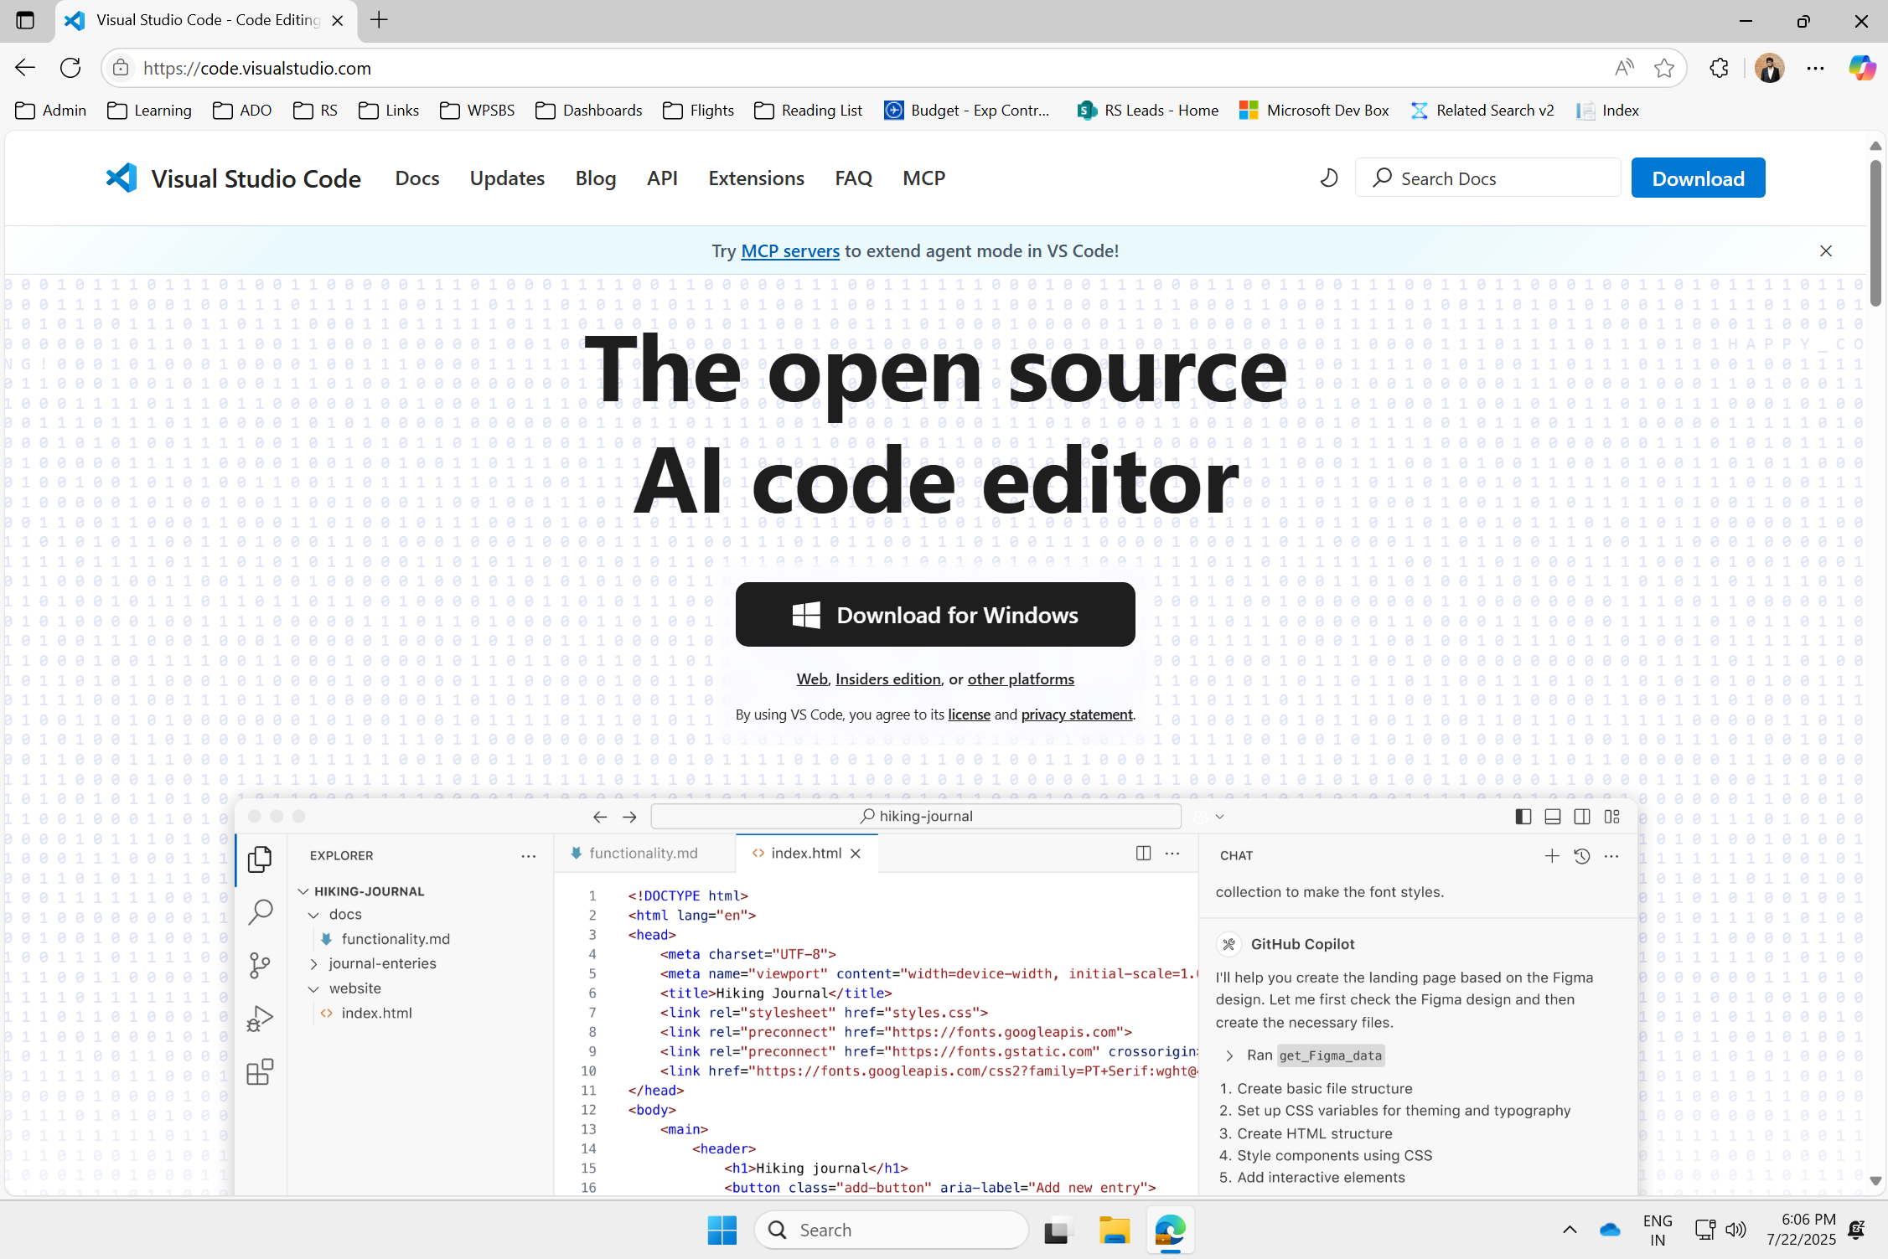
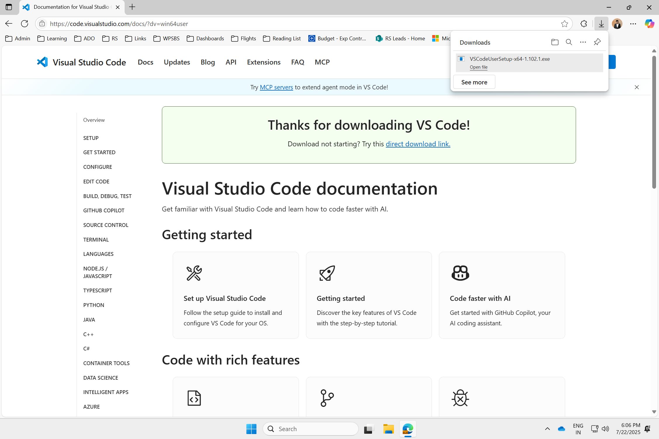
Steps to setup
Step #1: Install VS Code
Link: Download Visual Studio Code - Mac, Linux, Windows
#1: Download VS Code
Notes:
5 mins.

Slide 5
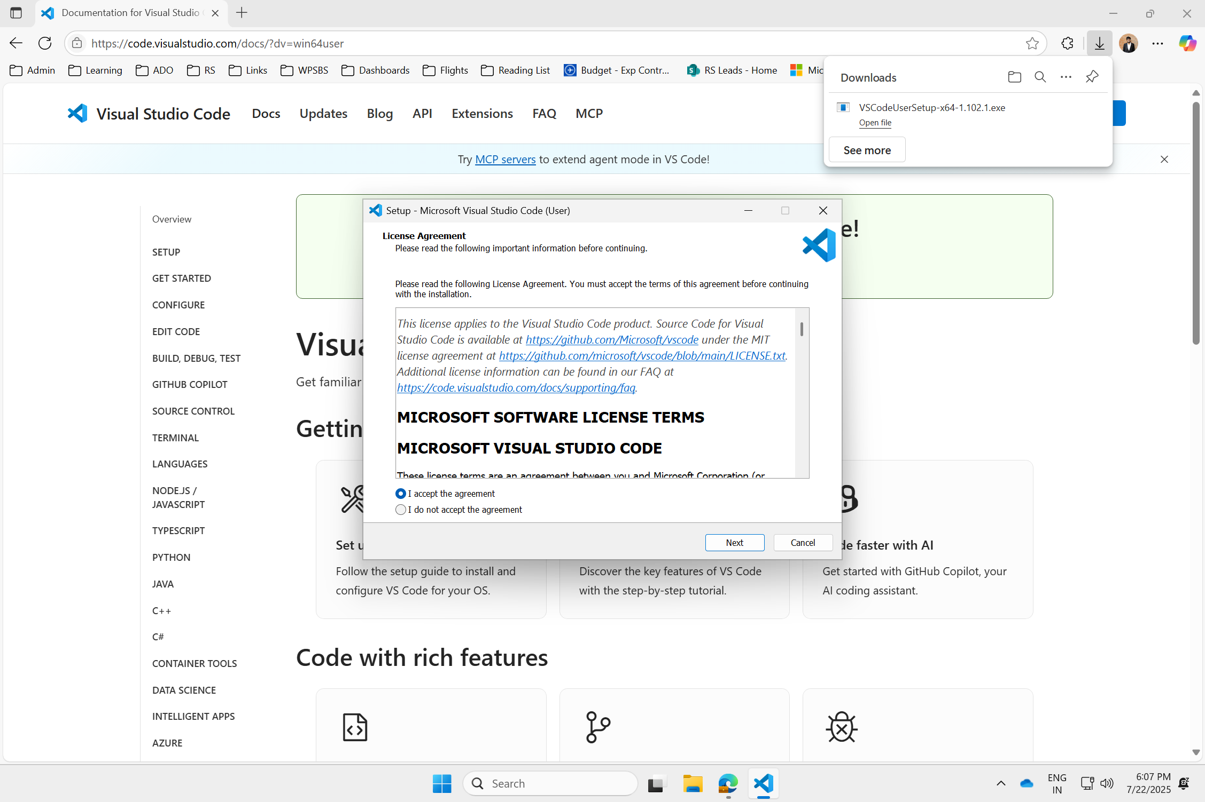
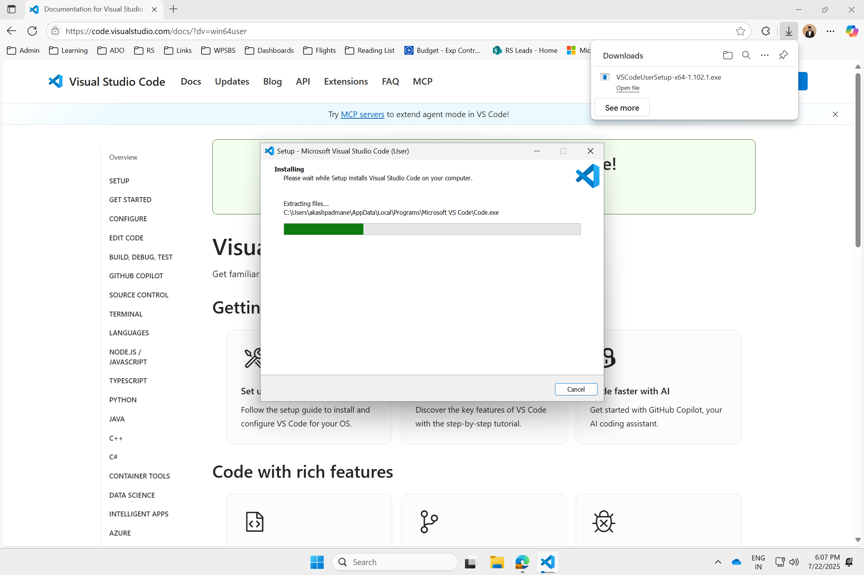
Steps to setup
Step #1: Install VS Code
Link: Download Visual Studio Code - Mac, Linux, Windows
#2: Complete VS Code Setup
Notes:
5 mins.

Slide 6
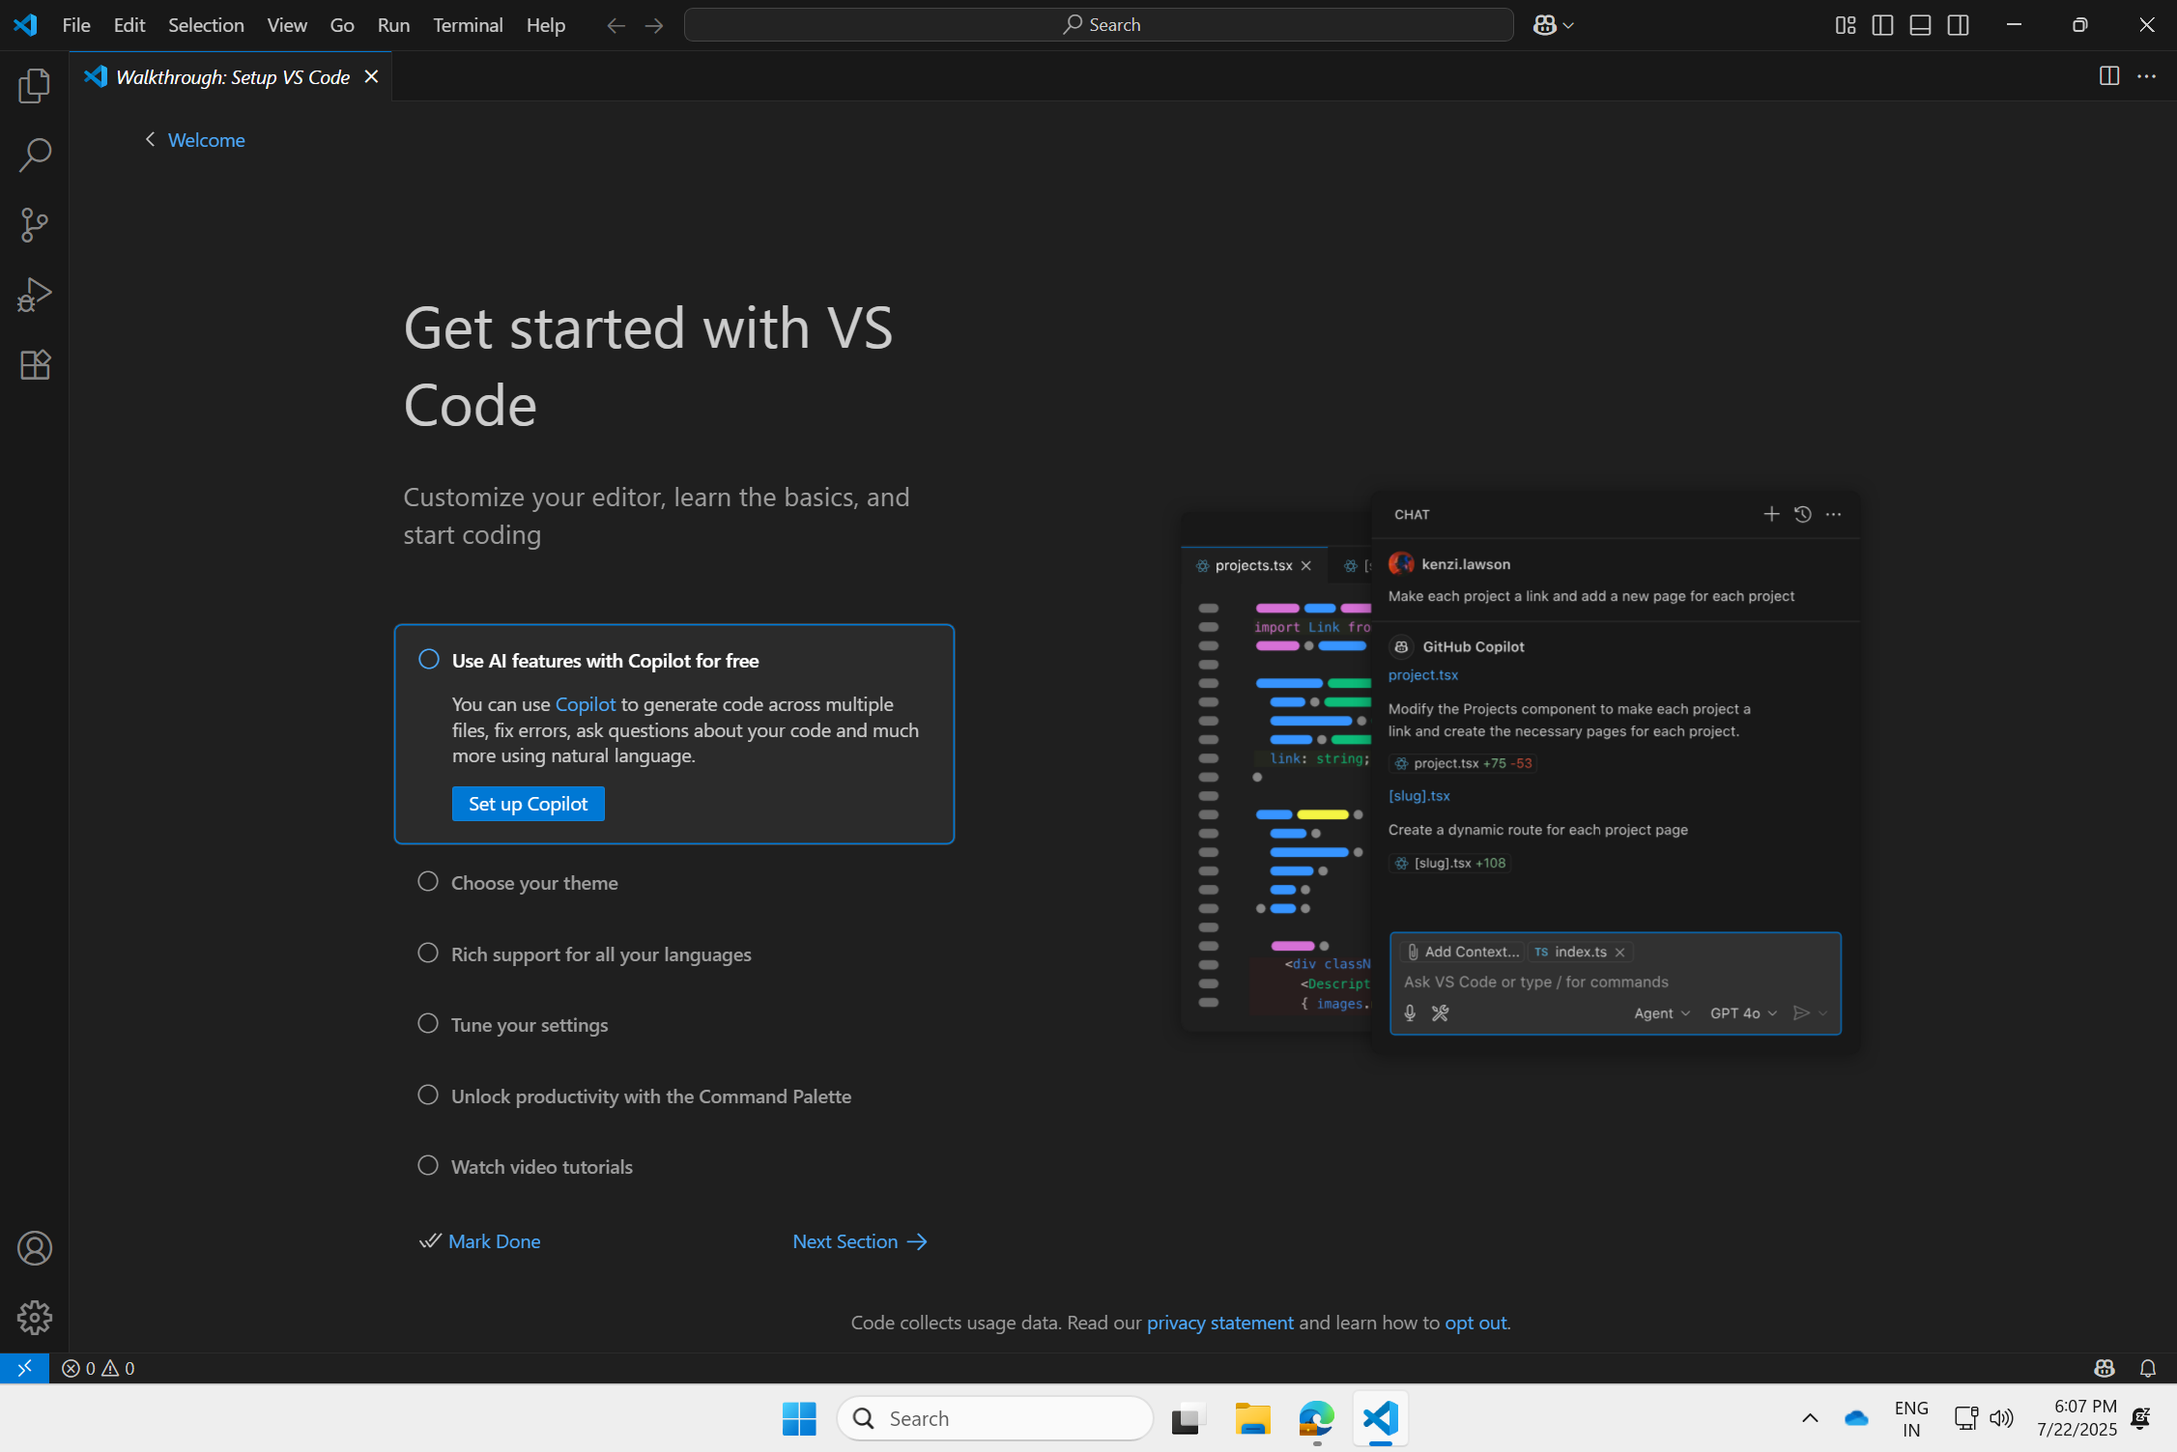
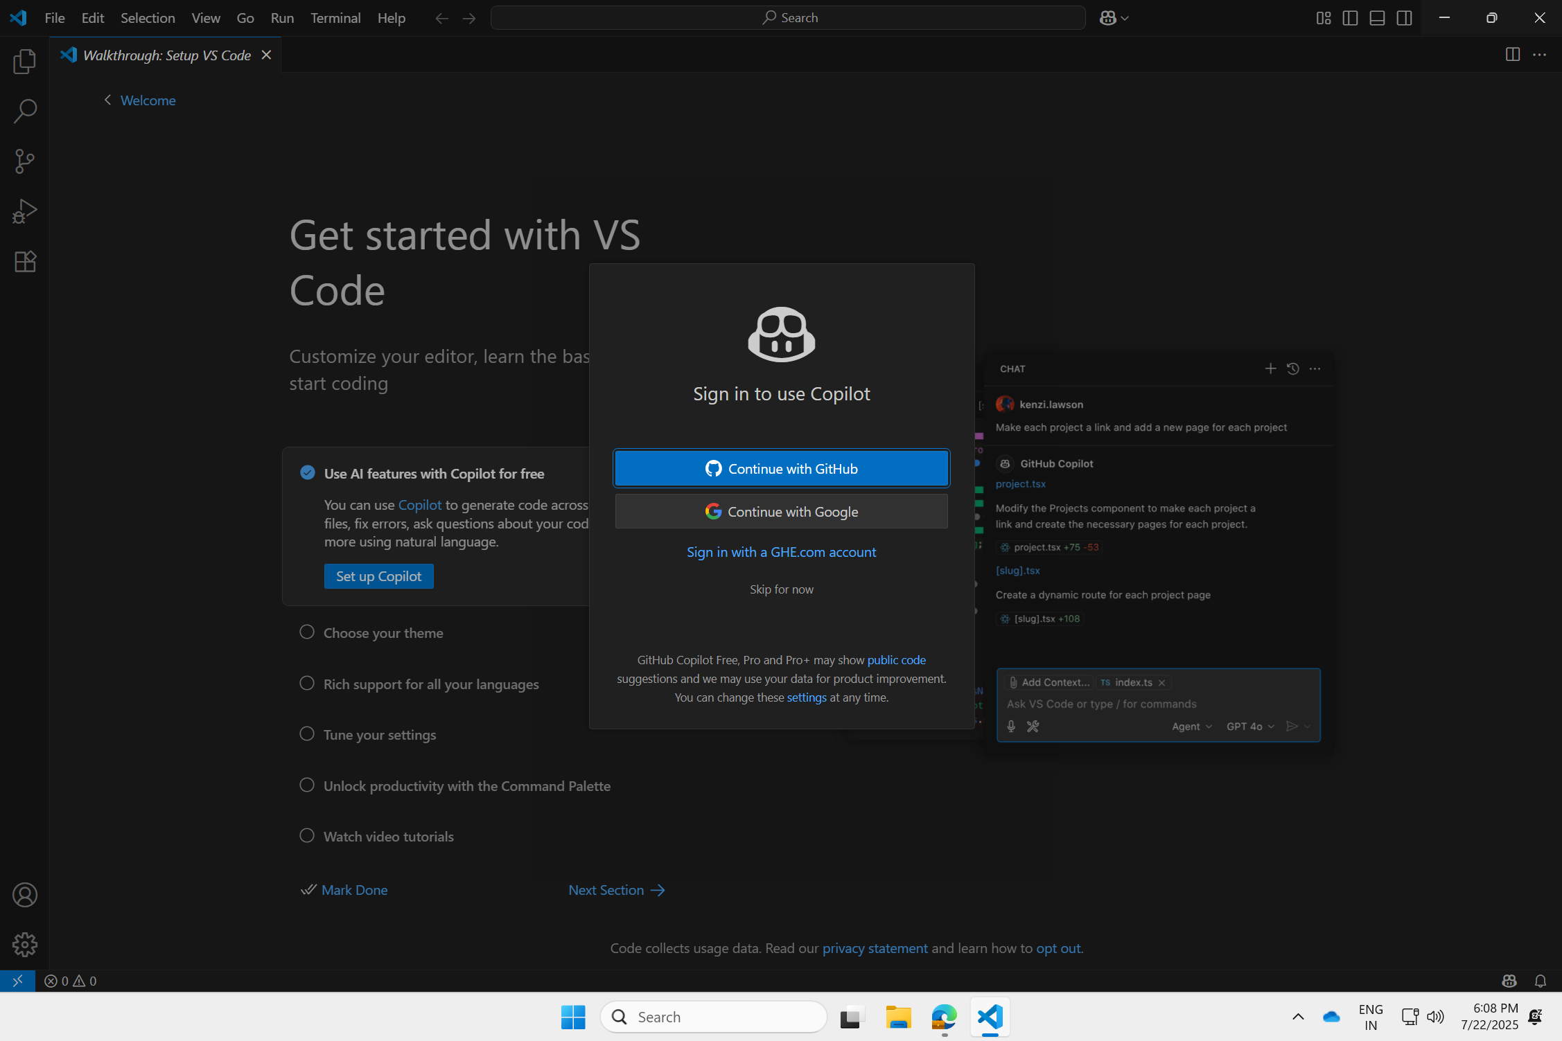
Steps to setup
Step #2: Set up GitHub Copilot
Select "Set Up Copilot" followed by "Continue with GitHub
#3: Setup GitHub Copilot
Notes:
5 mins.

Slide 7
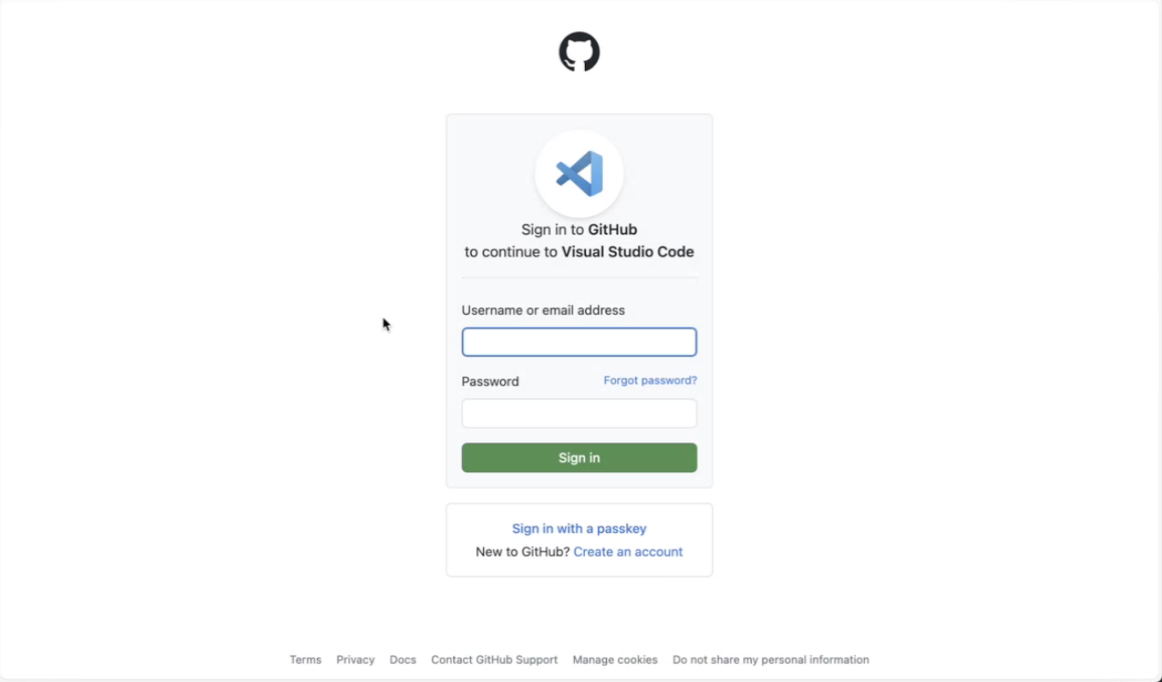
Steps to setup
Step #4: Set up GitHub Copilot
Use personal Gmail account for this
#4: Login with personal gmail account
Notes:
5 mins.

Slide 8
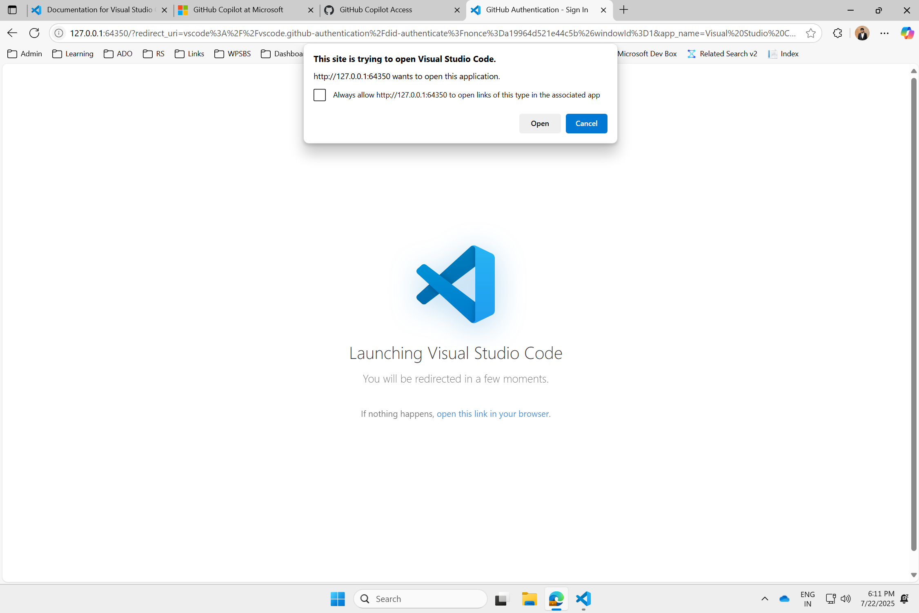
Steps to setup
Step #2: Set up GitHub Copilot
Link: Download Visual Studio Code - Mac, Linux, Windows
#4: Open VS Code from gmail account
Notes:
5 mins.

Slide 9
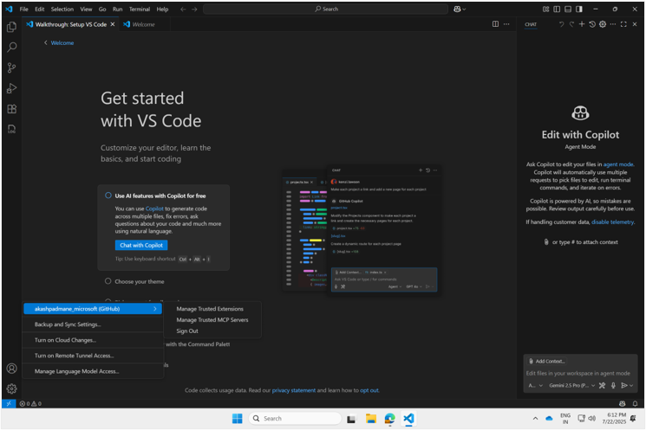


Confirmation screen
Use personal account
Ask → Agent
Model: Claude Sonnet 4
#5: Check & Confirm
Notes:
5 mins.

Slide 10
Getting the most out of the workshop:
Setting up VS Code and GitHub Copilot
Open mind: embrace this as a hands-on exploration of GitHub Copilot
Build understanding.
Have fun - enjoy the process.
Be a “learn-it-all” - connect and knowledge share.
Patience: there will be bumps.

Slide 11
Checkpoint #2
Now, are you ready with the setup (VS Code and GitHub Copilot)?
Yes. Let’s go forward
I will work with experts and catch up.
Notes:
Lets take 1 min – for folks who have “No” –
Online moderator – drops setup instructions on Chat and folks can post the step at which they are stuck

Slide 12
Using AI to accelerate your Innovation
Lets Get Started
Let's Make a Pacman Game!

Slide 13
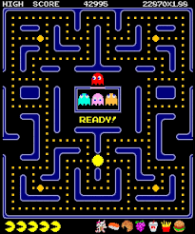
Using AI to accelerate your Innovation
Basics First
What is Pacman Game?
Ghosts
Pacman!
Points
Maze
Notes:
Write in the chat folks…

Slide 14



Using AI to accelerate your Innovation
Milestones
Milestone #1
Milestone #2
Milestone #3

Slide 15
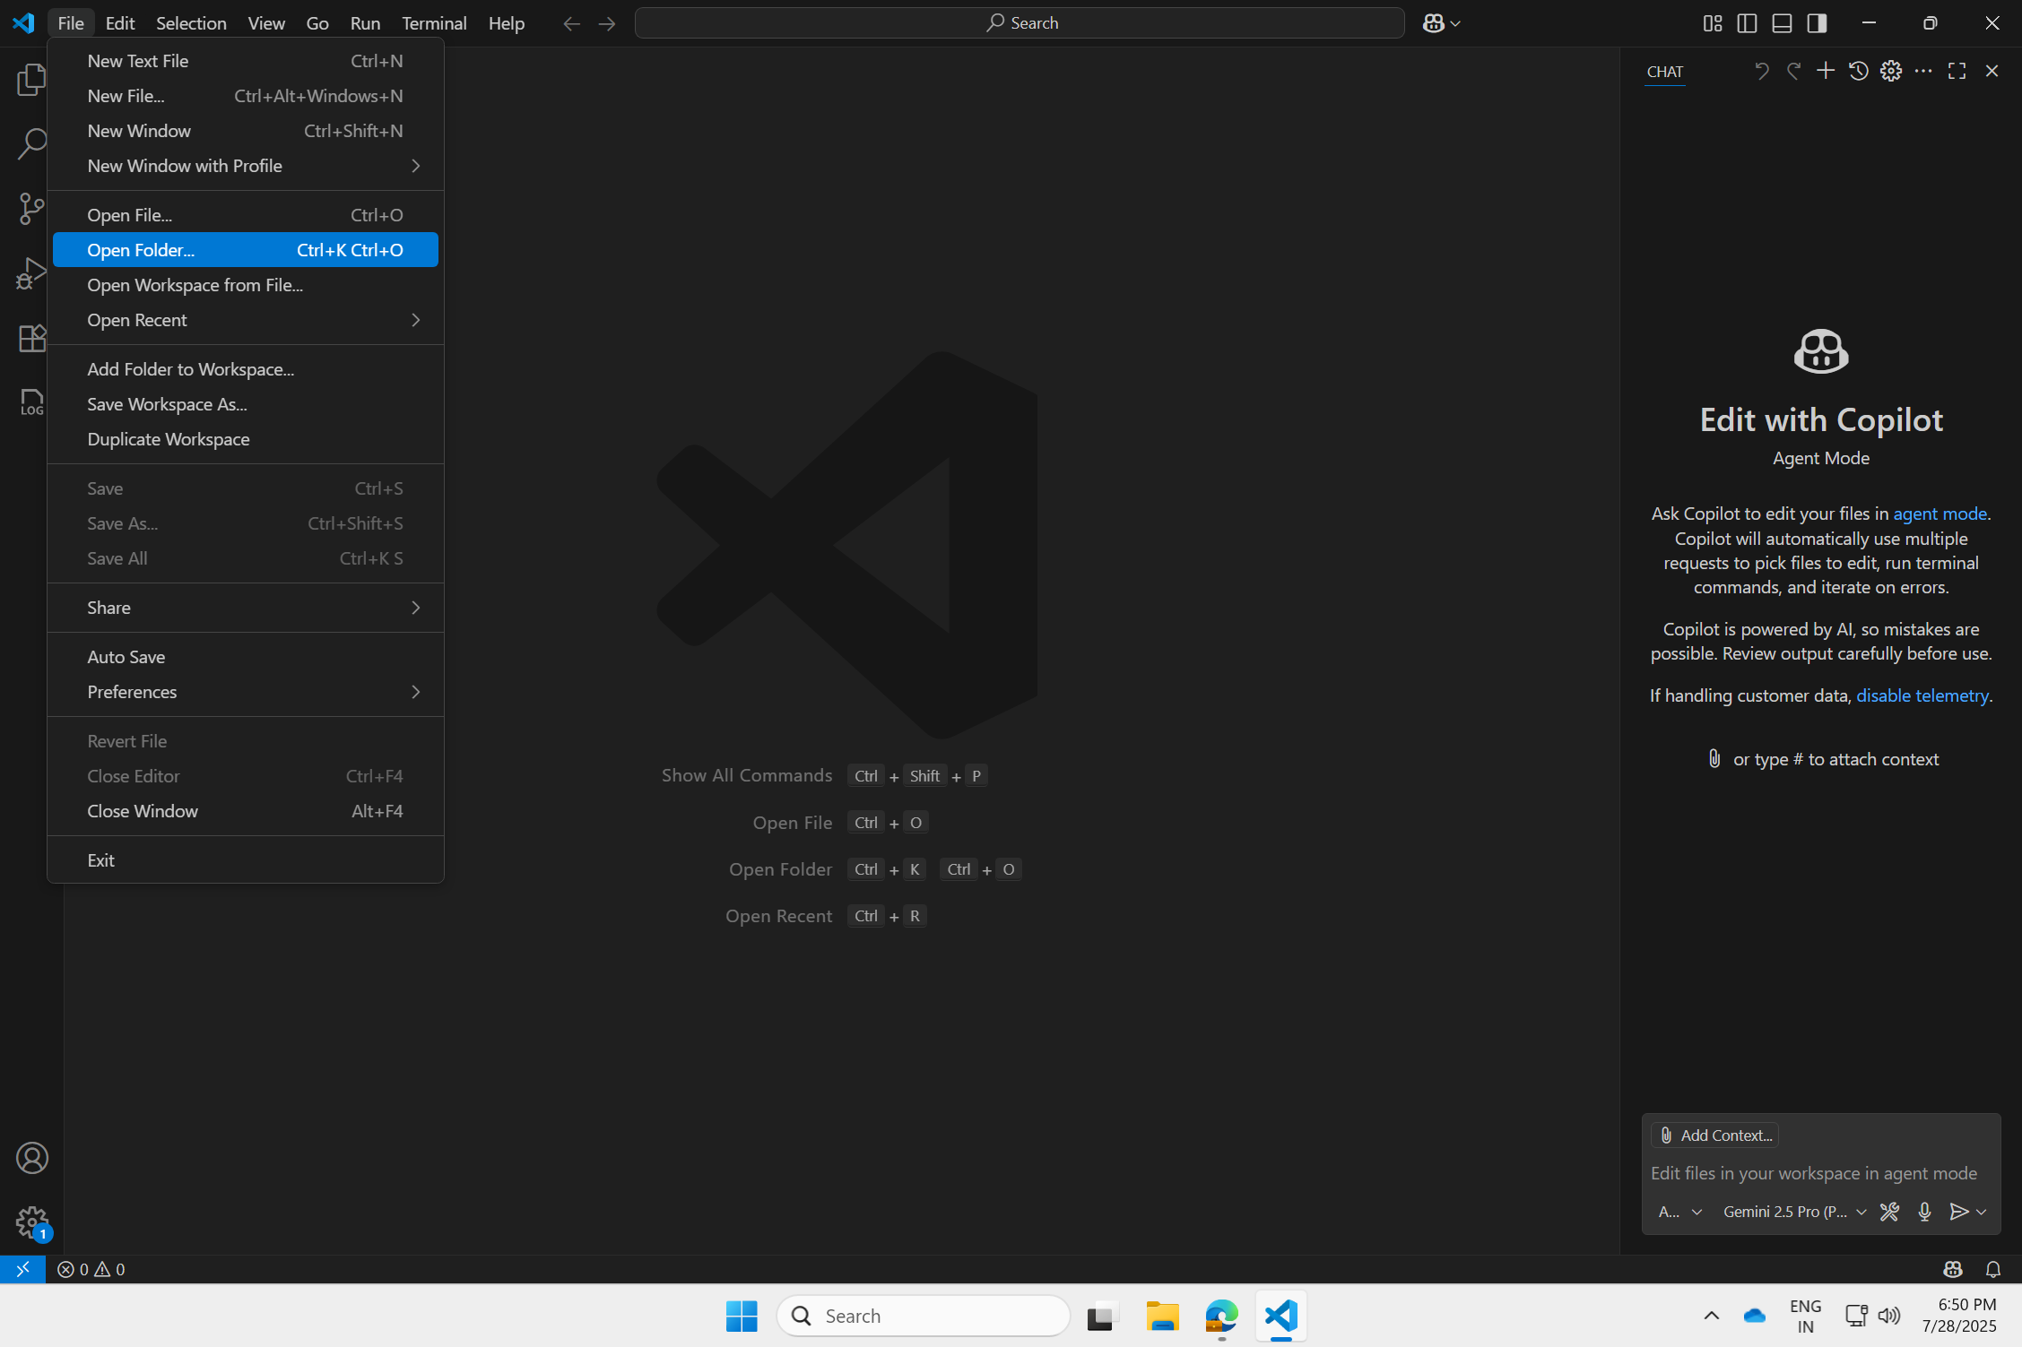
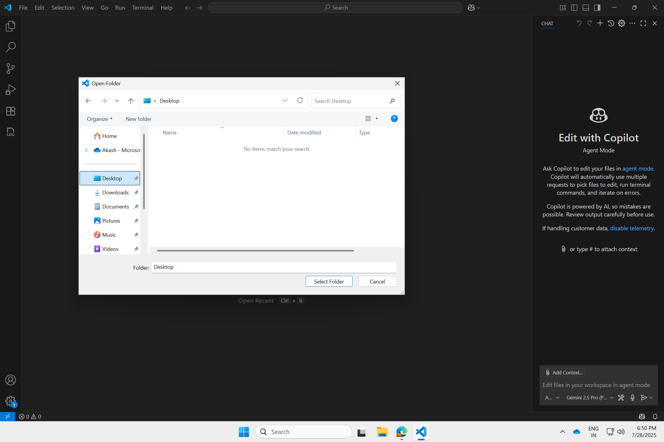
Using AI to accelerate your Innovation
Starting a Project
#1: Click “File”
And
“Open Folder”
#2: Click on “New Folder”

Slide 16
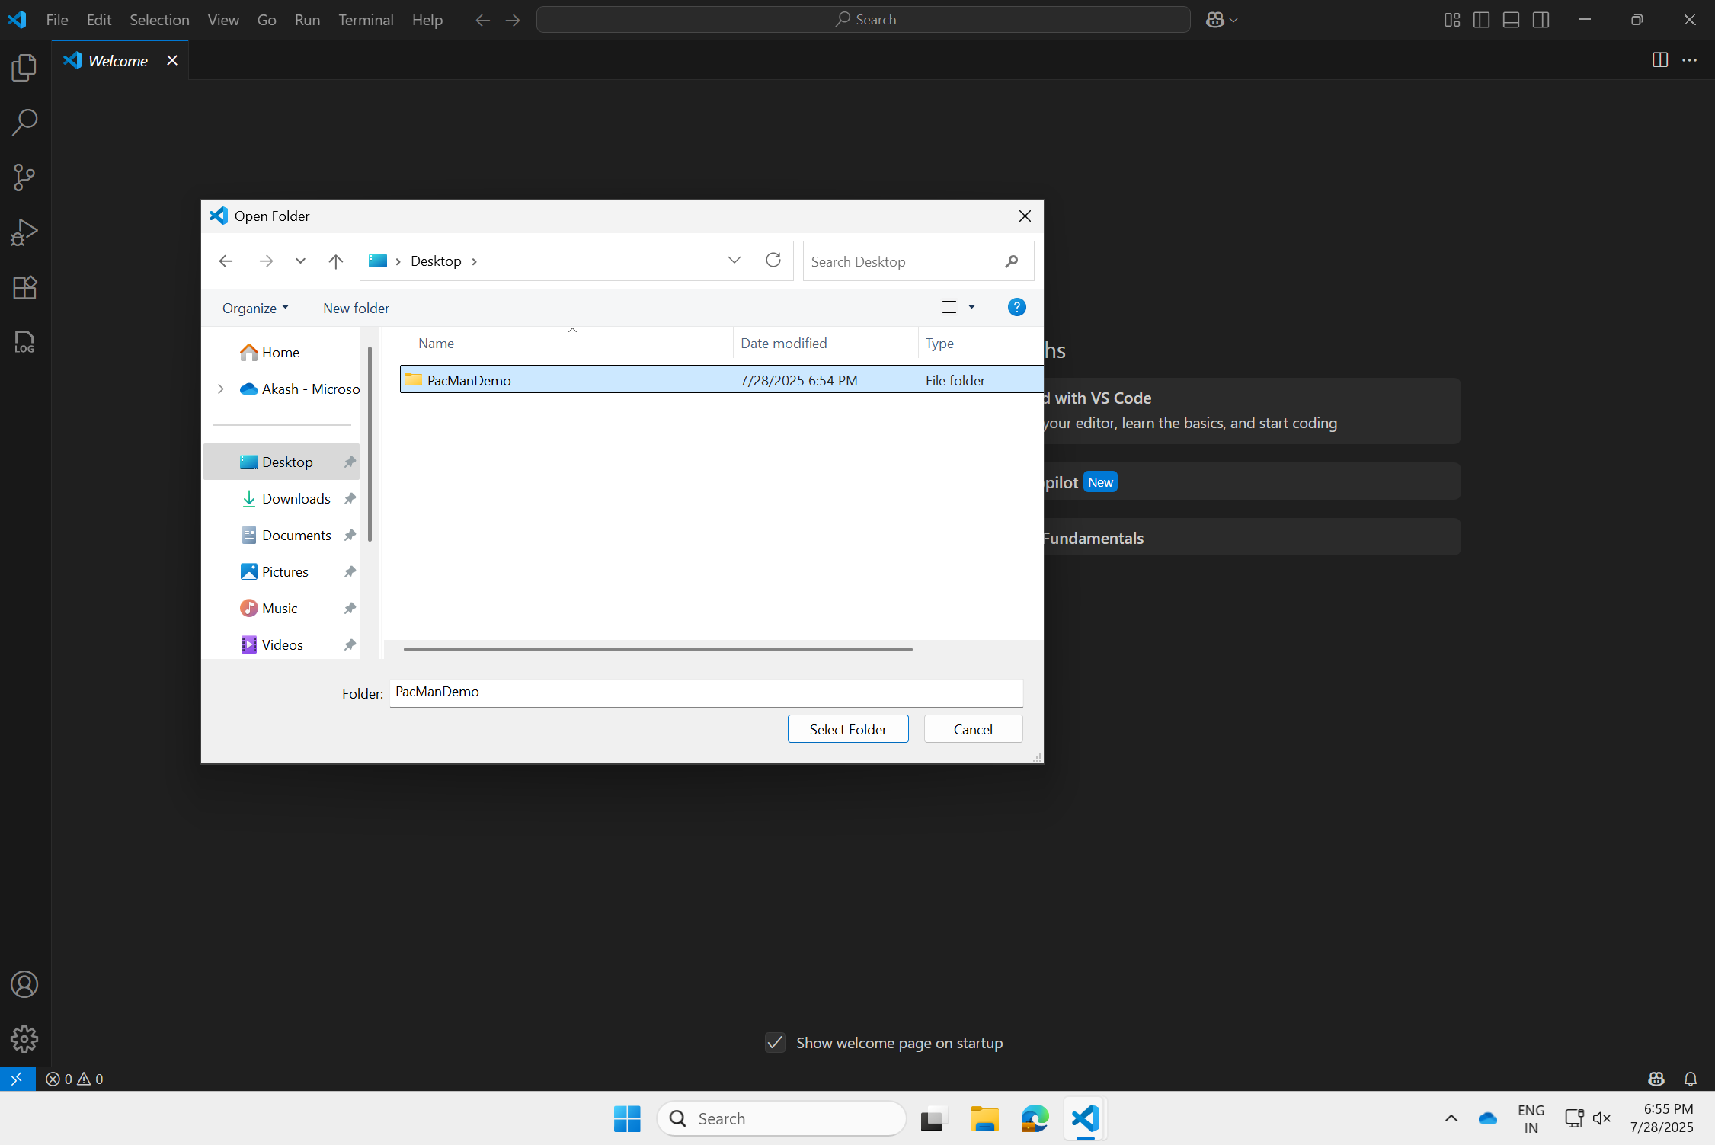
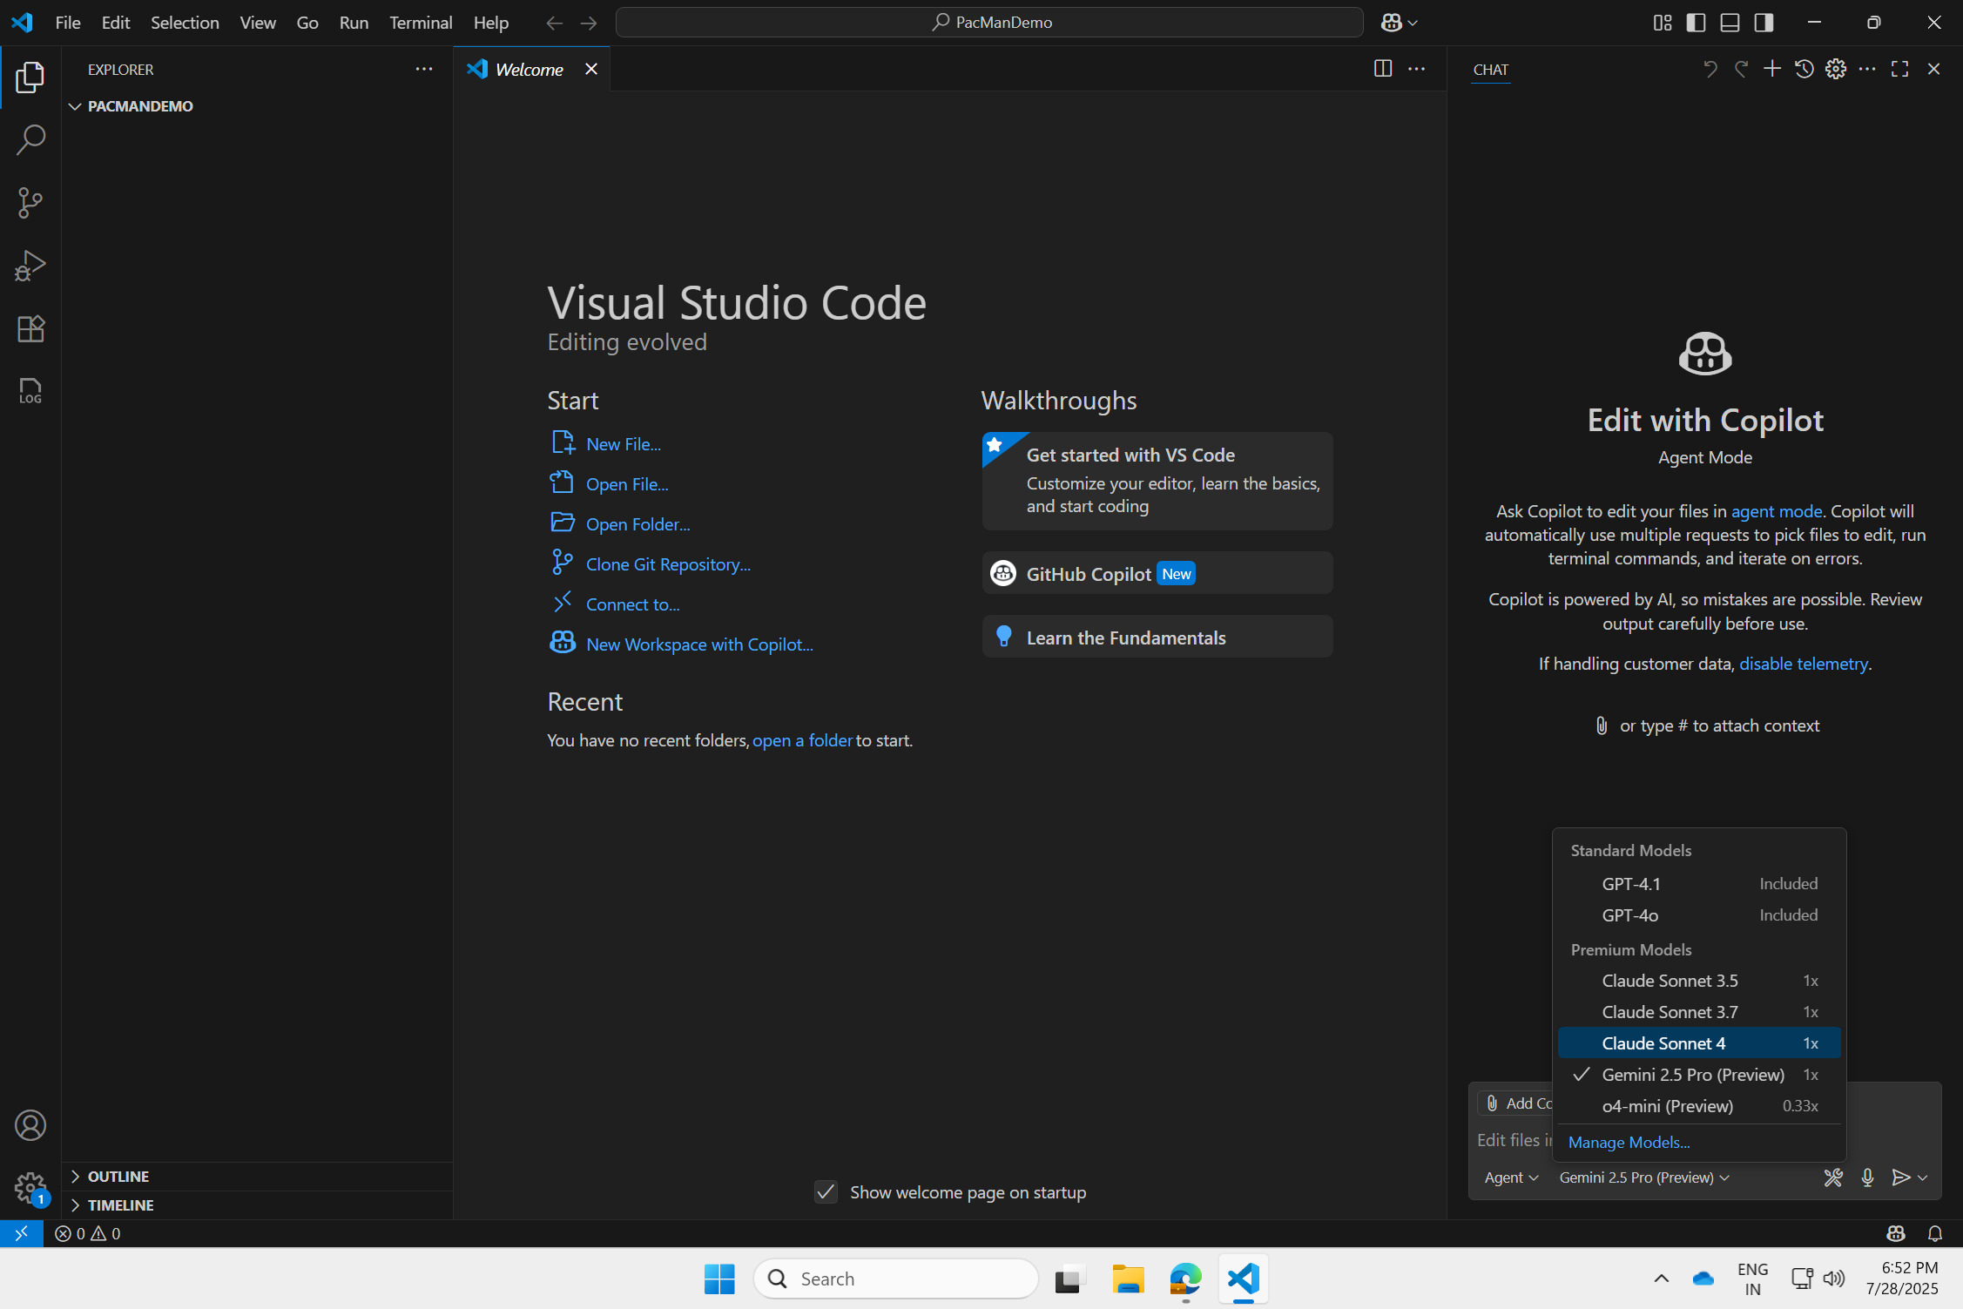
Using AI to accelerate your Innovation
Starting a Project
#3: Create new folder “PacMan Demo”
#4: Start GitHub Copilot in Agent Mode and Select “Claude Sonnet 4”
Notes:
Verbalize different modes – Ask, Edit & Agent – why are we using agent mode

Slide 17

Checkpoint #3
Are you ready with folder and go forward?
Yes. Let’s go forward.
Need help in the MPR.
Need help from online moderator.
Notes:
Lets take 1 min – for folks who have “No” –
Online moderator – drops setup instructions on Chat and folks can post the step at which they are stuck

Slide 18
Using AI to accelerate your Innovation
Adding Prompt to Agent
The objective is to create a simple game of pacman in HTML, CSS and JavaScript.
The following are a description of the basic rules and description of the game
Pac-Man: The Core Chase
The game features a yellow, chomping character navigating a twisty, blue maze. The player's primary goal is straightforward: eat all the tiny, sparkling dots scattered throughout the maze.
However, a challenge exists! A single, red, spooky ghost constantly floats through the maze. This ghost moves autonomously and relentlessly pursues Pac-Man.
Pac-Man is controlled by the player, moving up, down, left, or right along the maze paths.
Every dot Pac-Man eats disappears and contributes to the player's score.
If the red ghost touches Pac-Man, Pac-Man loses one of his lives (chances).
If all dots are eaten, the player wins the level.
If Pac-Man runs out of lives, the game is over.
The core gameplay centers on quickly navigating the maze, collecting dots, and outsmarting the single, determined ghost. It offers a simple, fun, and addictive experience.
Additionally, i have also attached a reference of how the game should look like - use that as a reference if needed
#5: Add Prompt to the GitHub Copilot Agent
Notes:
Verbalize what the prompt does and why is it written in this way – esp. HTML, CSS and Javascript?

Slide 19
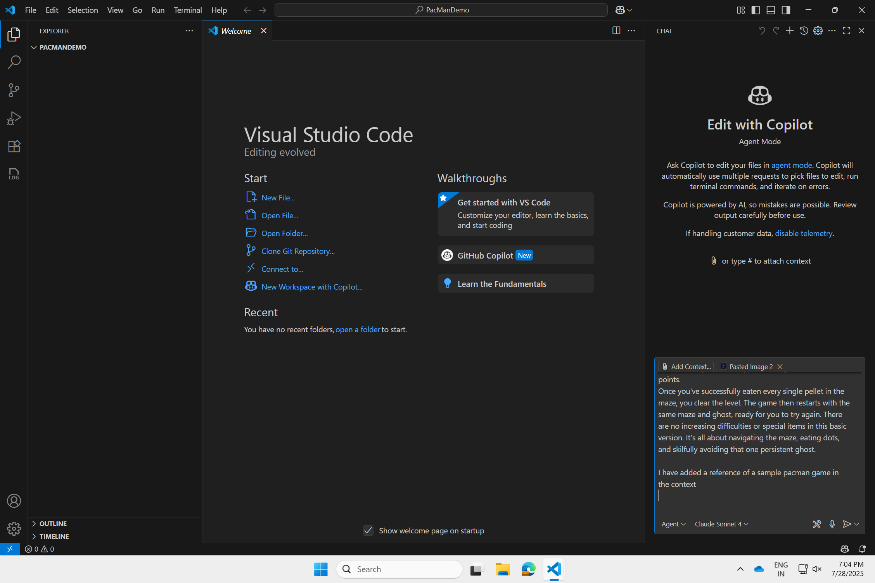
Using AI to accelerate your Innovation
Adding Prompt to Agent
#5: Add Prompt to the GitHub Copilot Agent
Notes:
Call out what is happening behind the scenes – agent is working

Slide 20
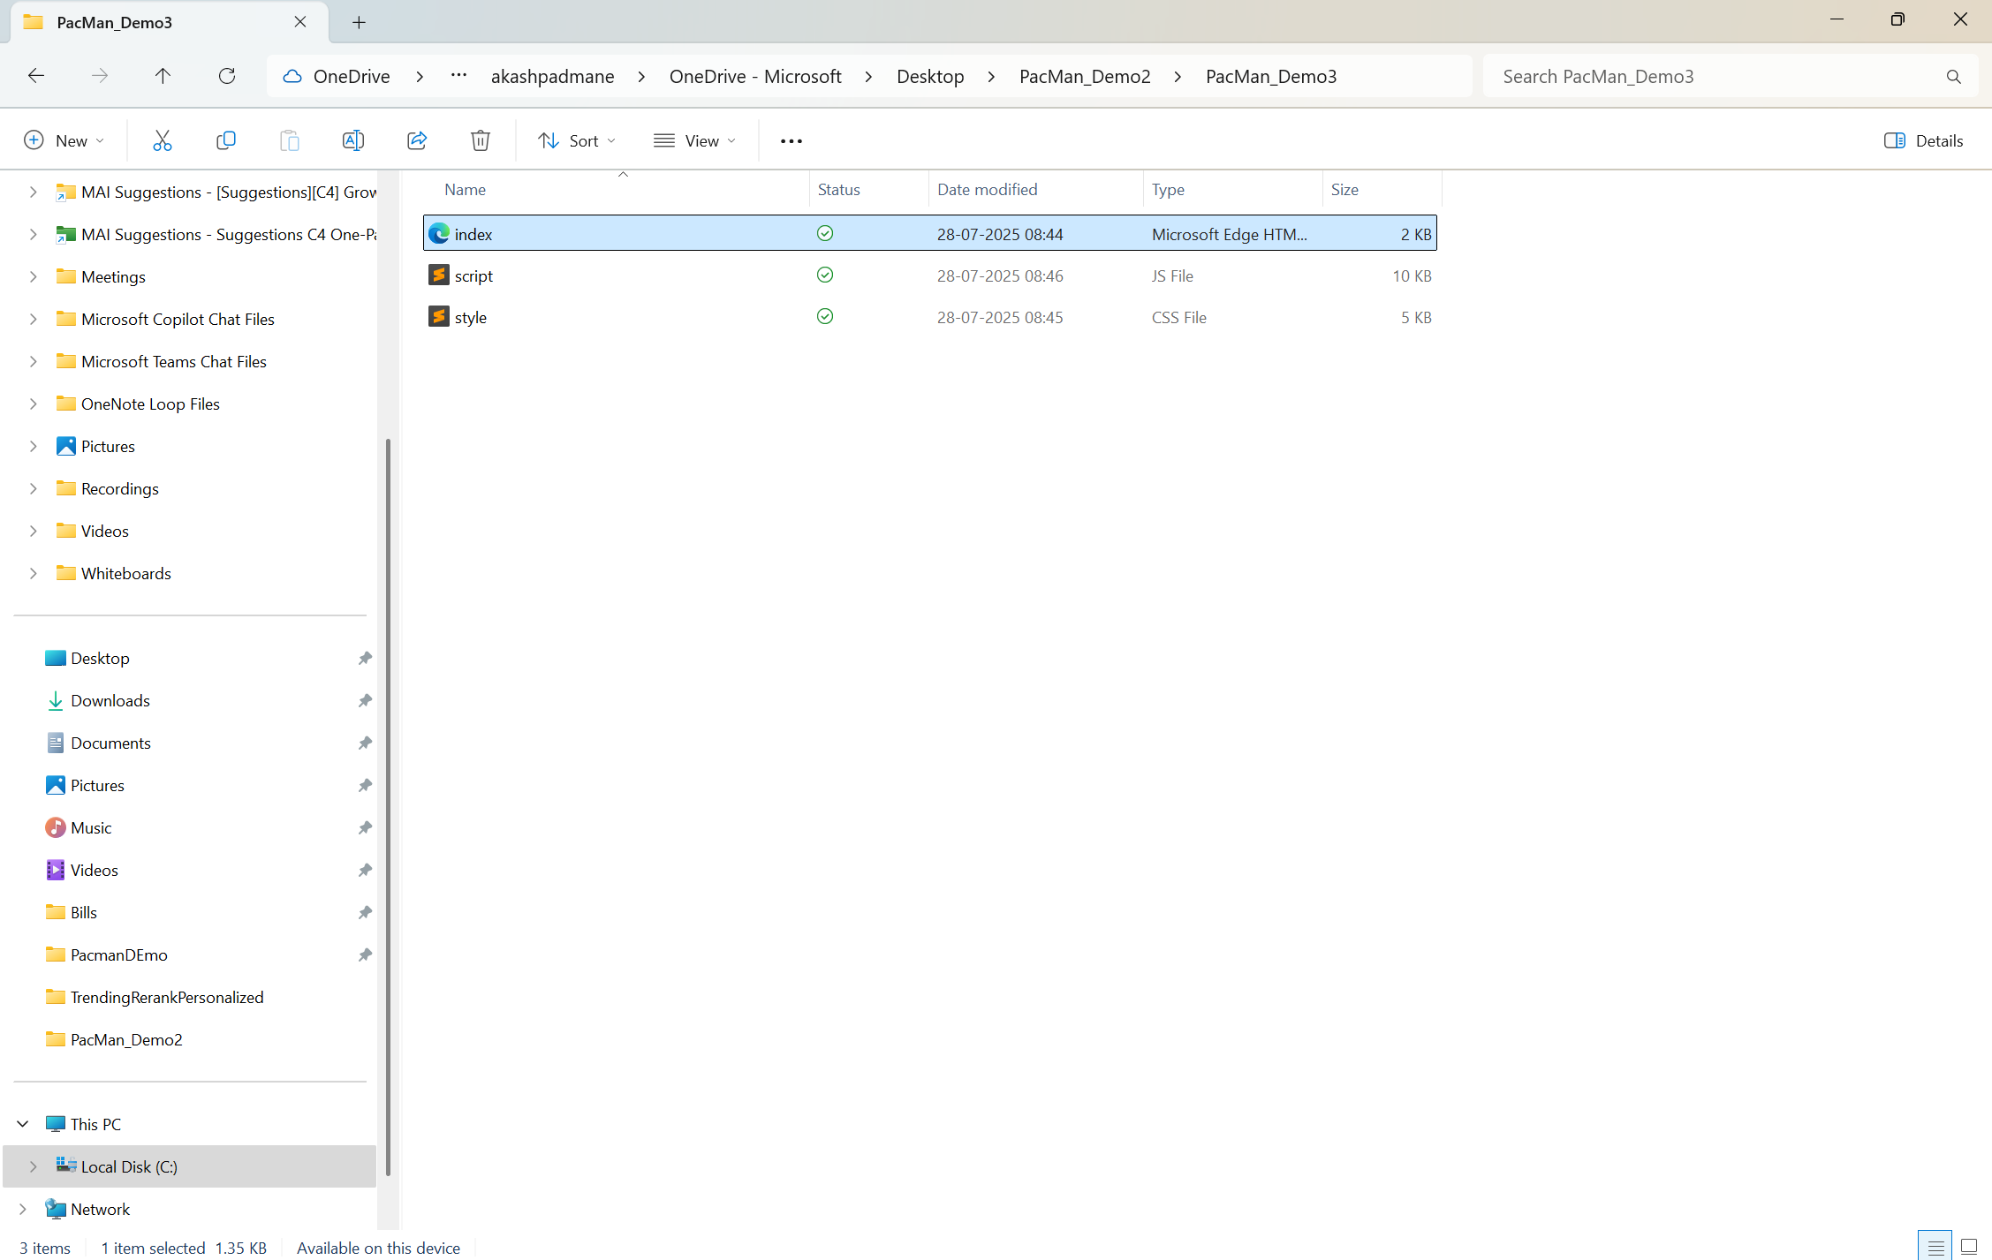
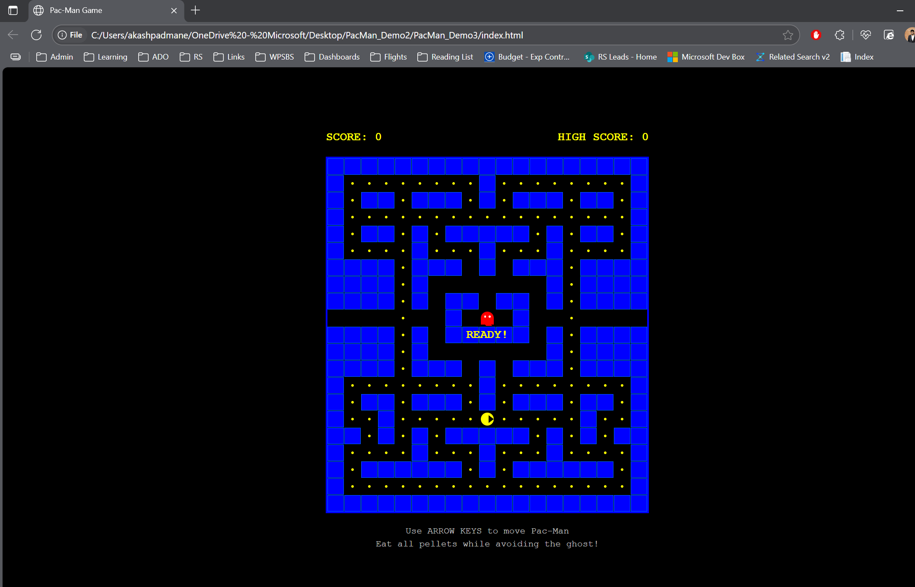
Using AI to accelerate your Innovation
Running your first game
Navigate to the Project Folder
Open “index.html” file in browser (Edge)
Notes:
Take screenshot and ask github to solve it

Slide 21
Using AI to accelerate your Innovation
Checkpoint #4
Are you able to run the first version of your Pacman game?
Yes
No
Notes:
Take screenshot and ask github to solve it

Slide 22
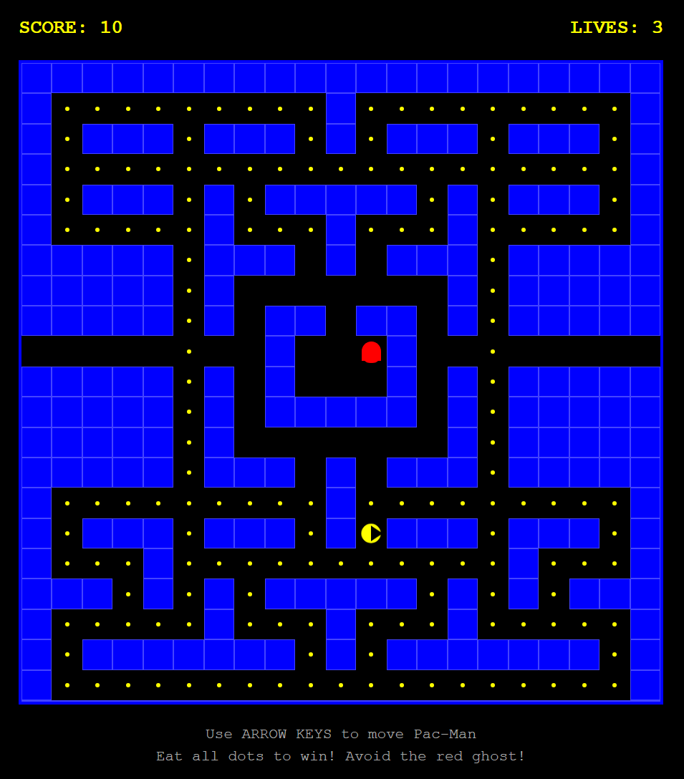
Using AI to accelerate your Innovation
Milestone #2: Making your first Edit
Seems like there are very few “Points” for Pacman
Head back to VS Code & Make an Edit
In-case of issues – take screenshot and ask copilot to make fixes with prompt instruction
Prompt to be copied - Seems like there are very few dots that pacman can eat - can you add more?
Notes:
Take screenshot and ask github to solve it

Slide 23
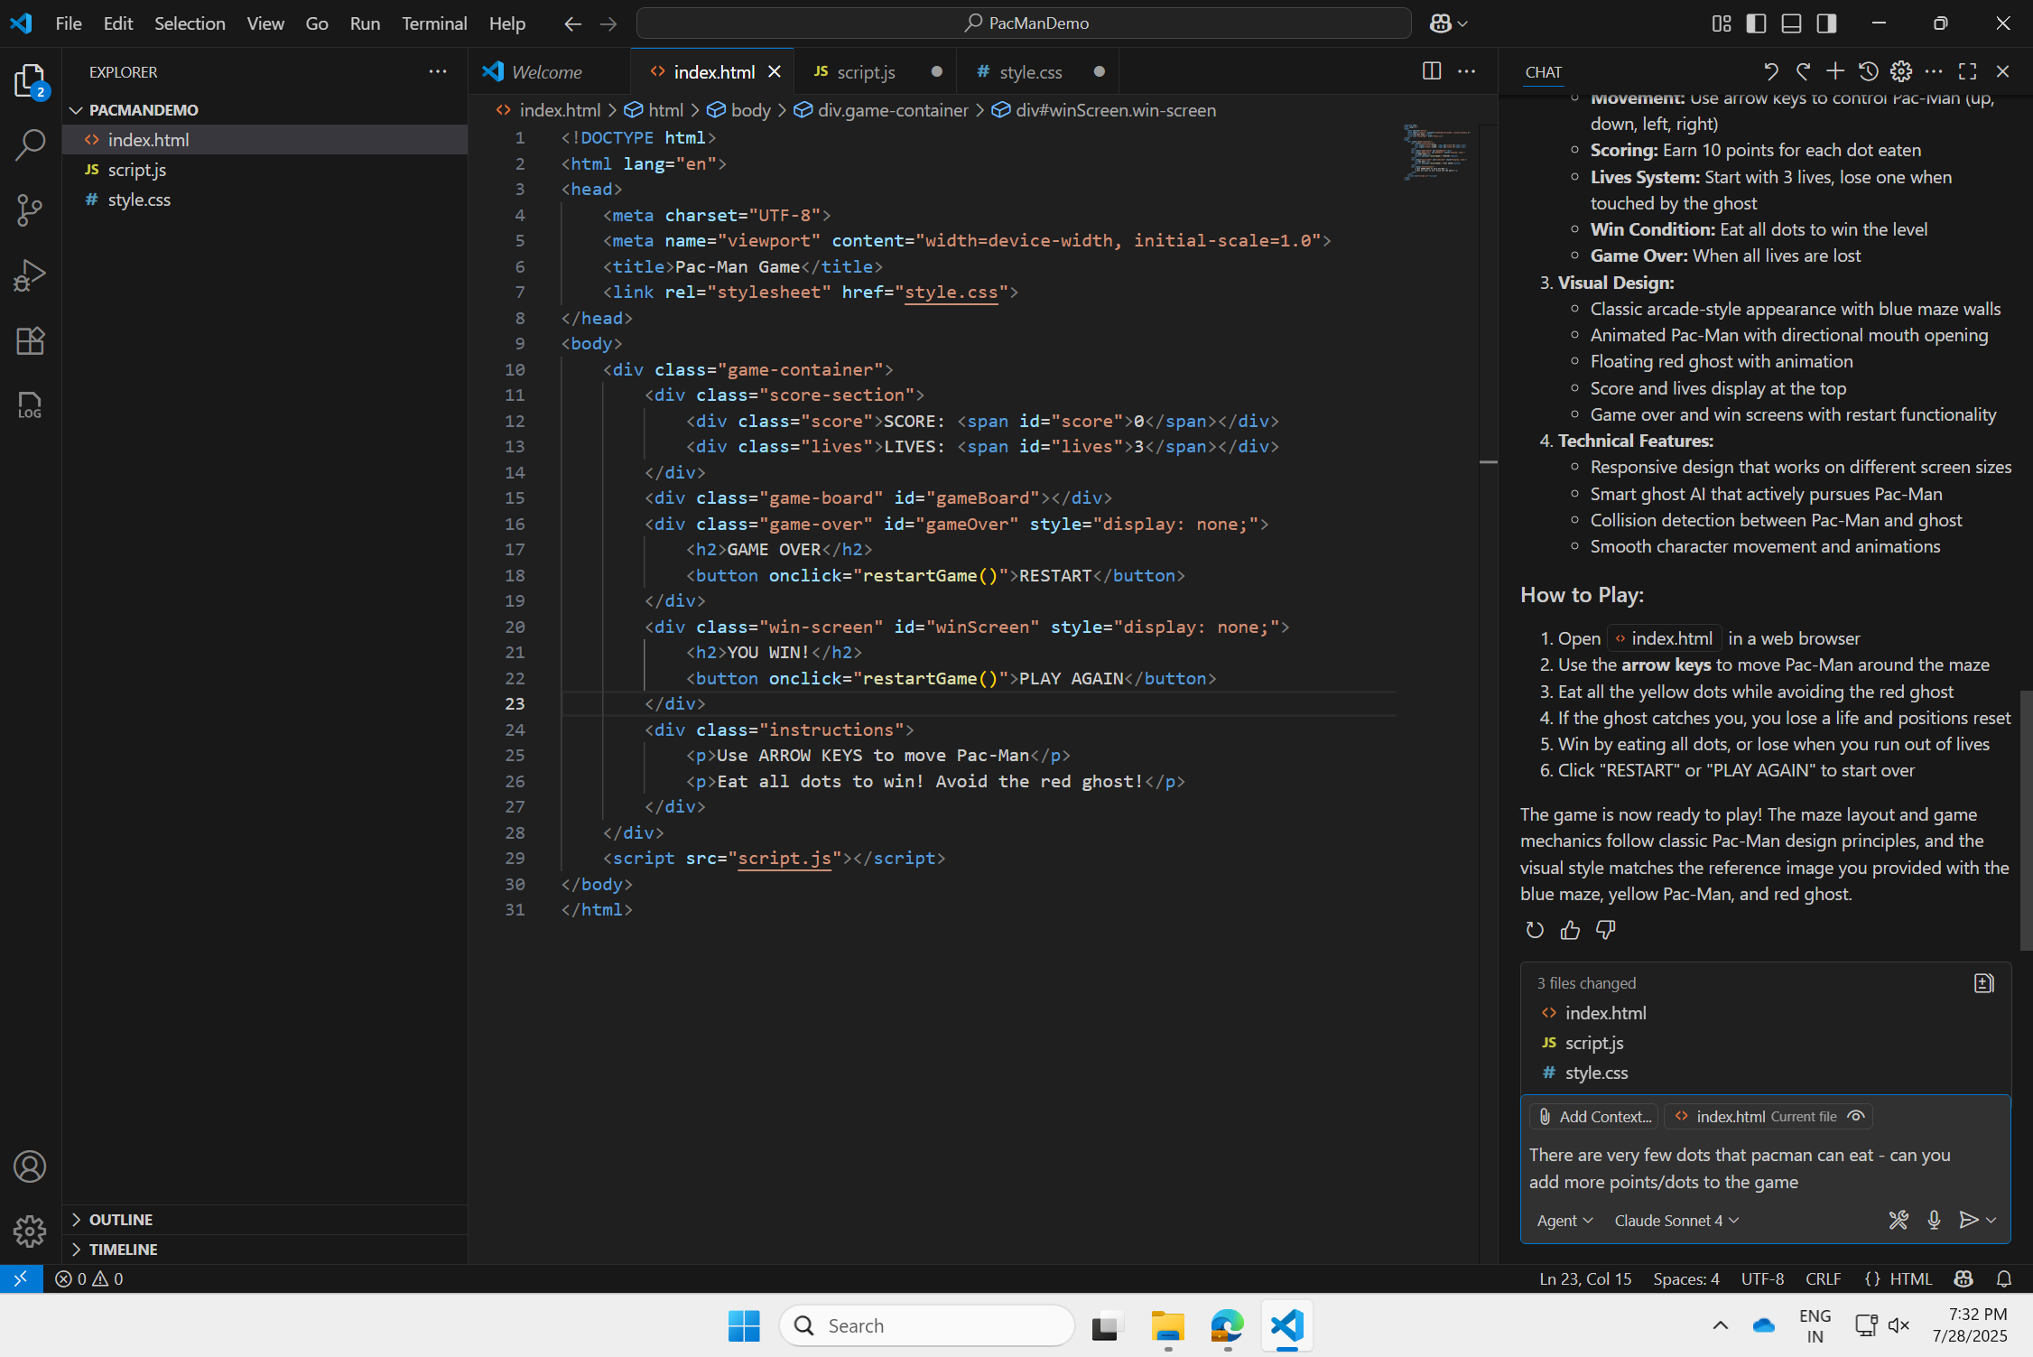
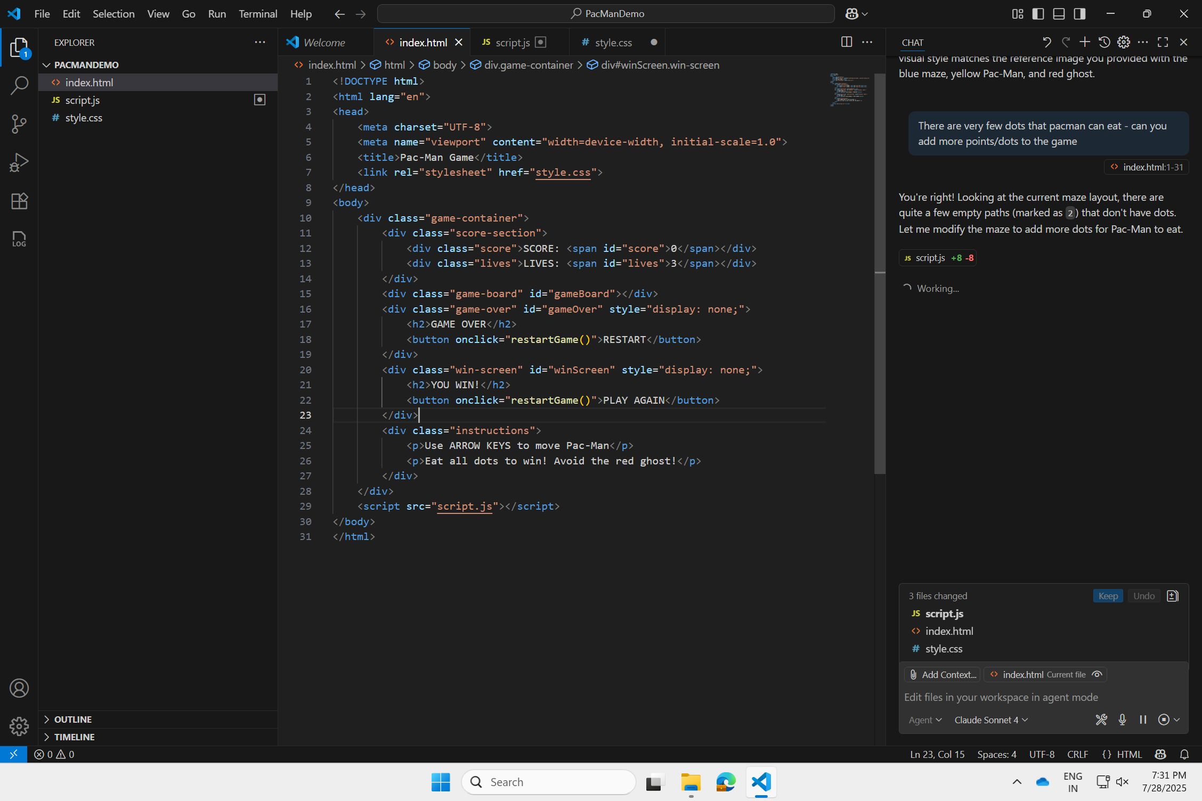
Using AI to accelerate your Innovation
Making your First Edit
#1: Add Prompt to the GitHub Copilot Agent
Notes:
Take screenshot and ask github to solve it

Slide 24
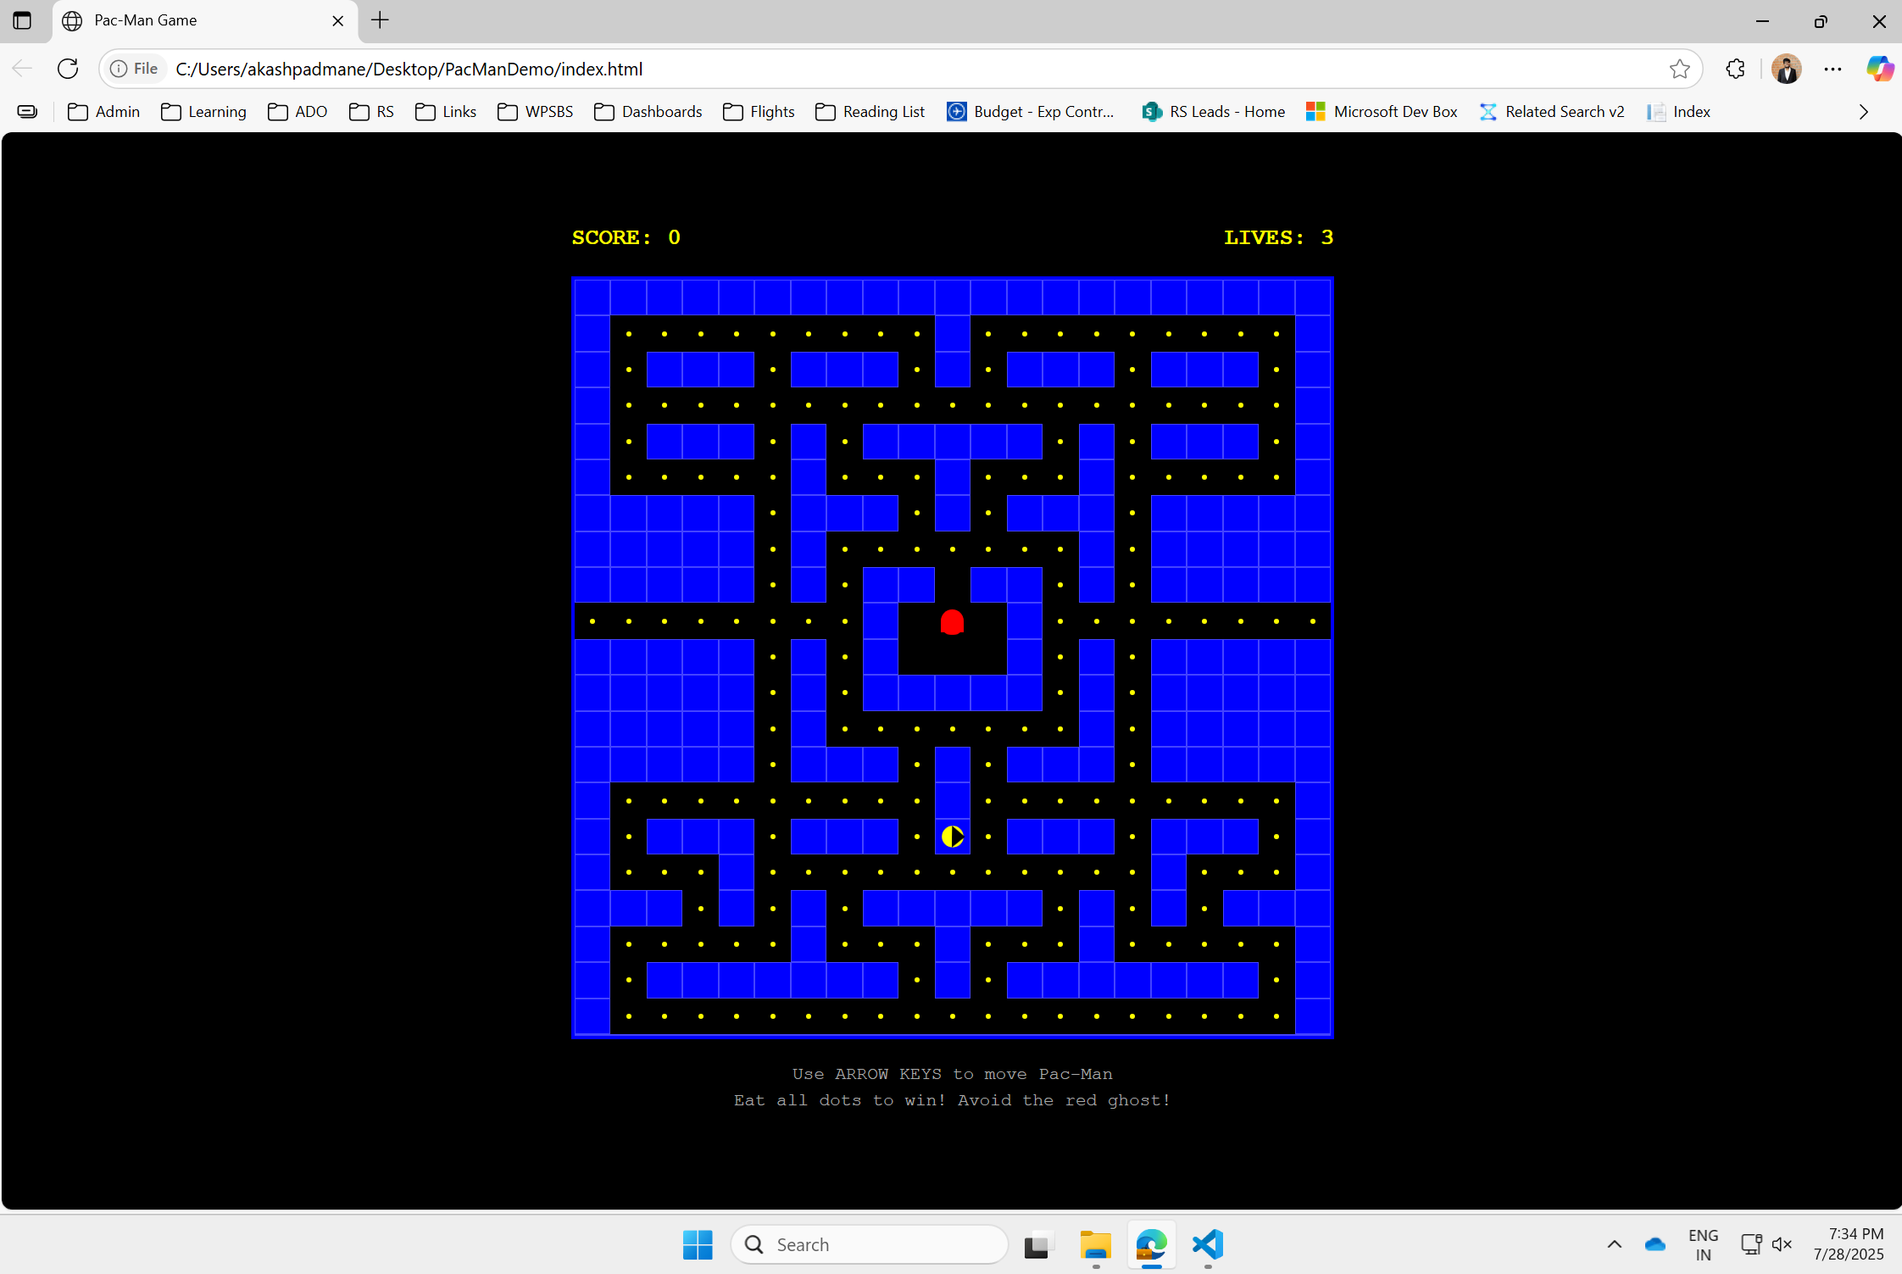
Using AI to accelerate your Innovation
Making your First Edit
#2: Once edits are done, re open ‘index.html’ in Edge
Notes:
Take screenshot and ask github to solve it

Slide 25

Checkpoint #5
Are you able to edit and run the updated version of your game?
Yes
No
Notes:
3-5 min gap to follow instructions, update status in Poll & share screenshot

Slide 26
Using AI to accelerate your Innovation
Milestone #3: Adding New Features
Can we add 3 ‘Ghosts’ instead of 1
Head back to VS Code & Make and Edit
Currently the game only consists of one ghost chasing pacman, make required changes to ensure there are three ghosts that chase pacman
Notes:
Take screenshot and ask github to solve it

Slide 27
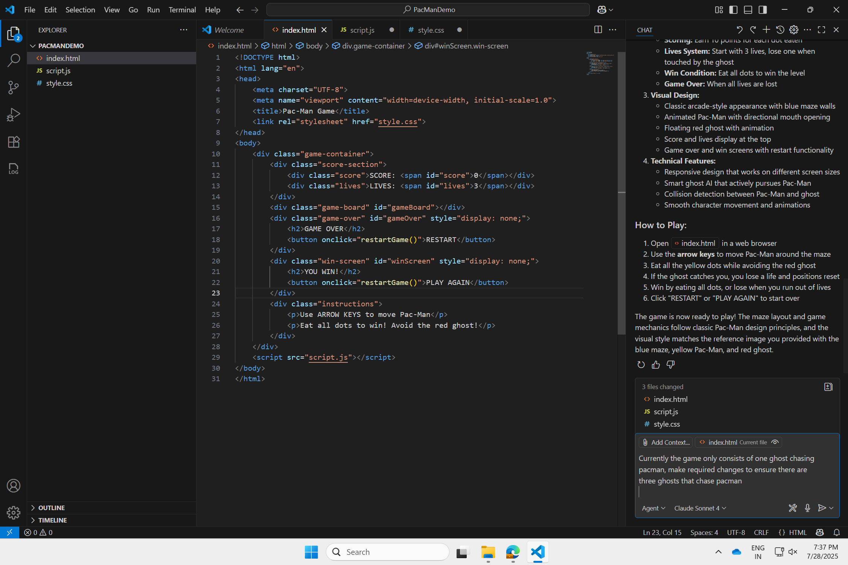
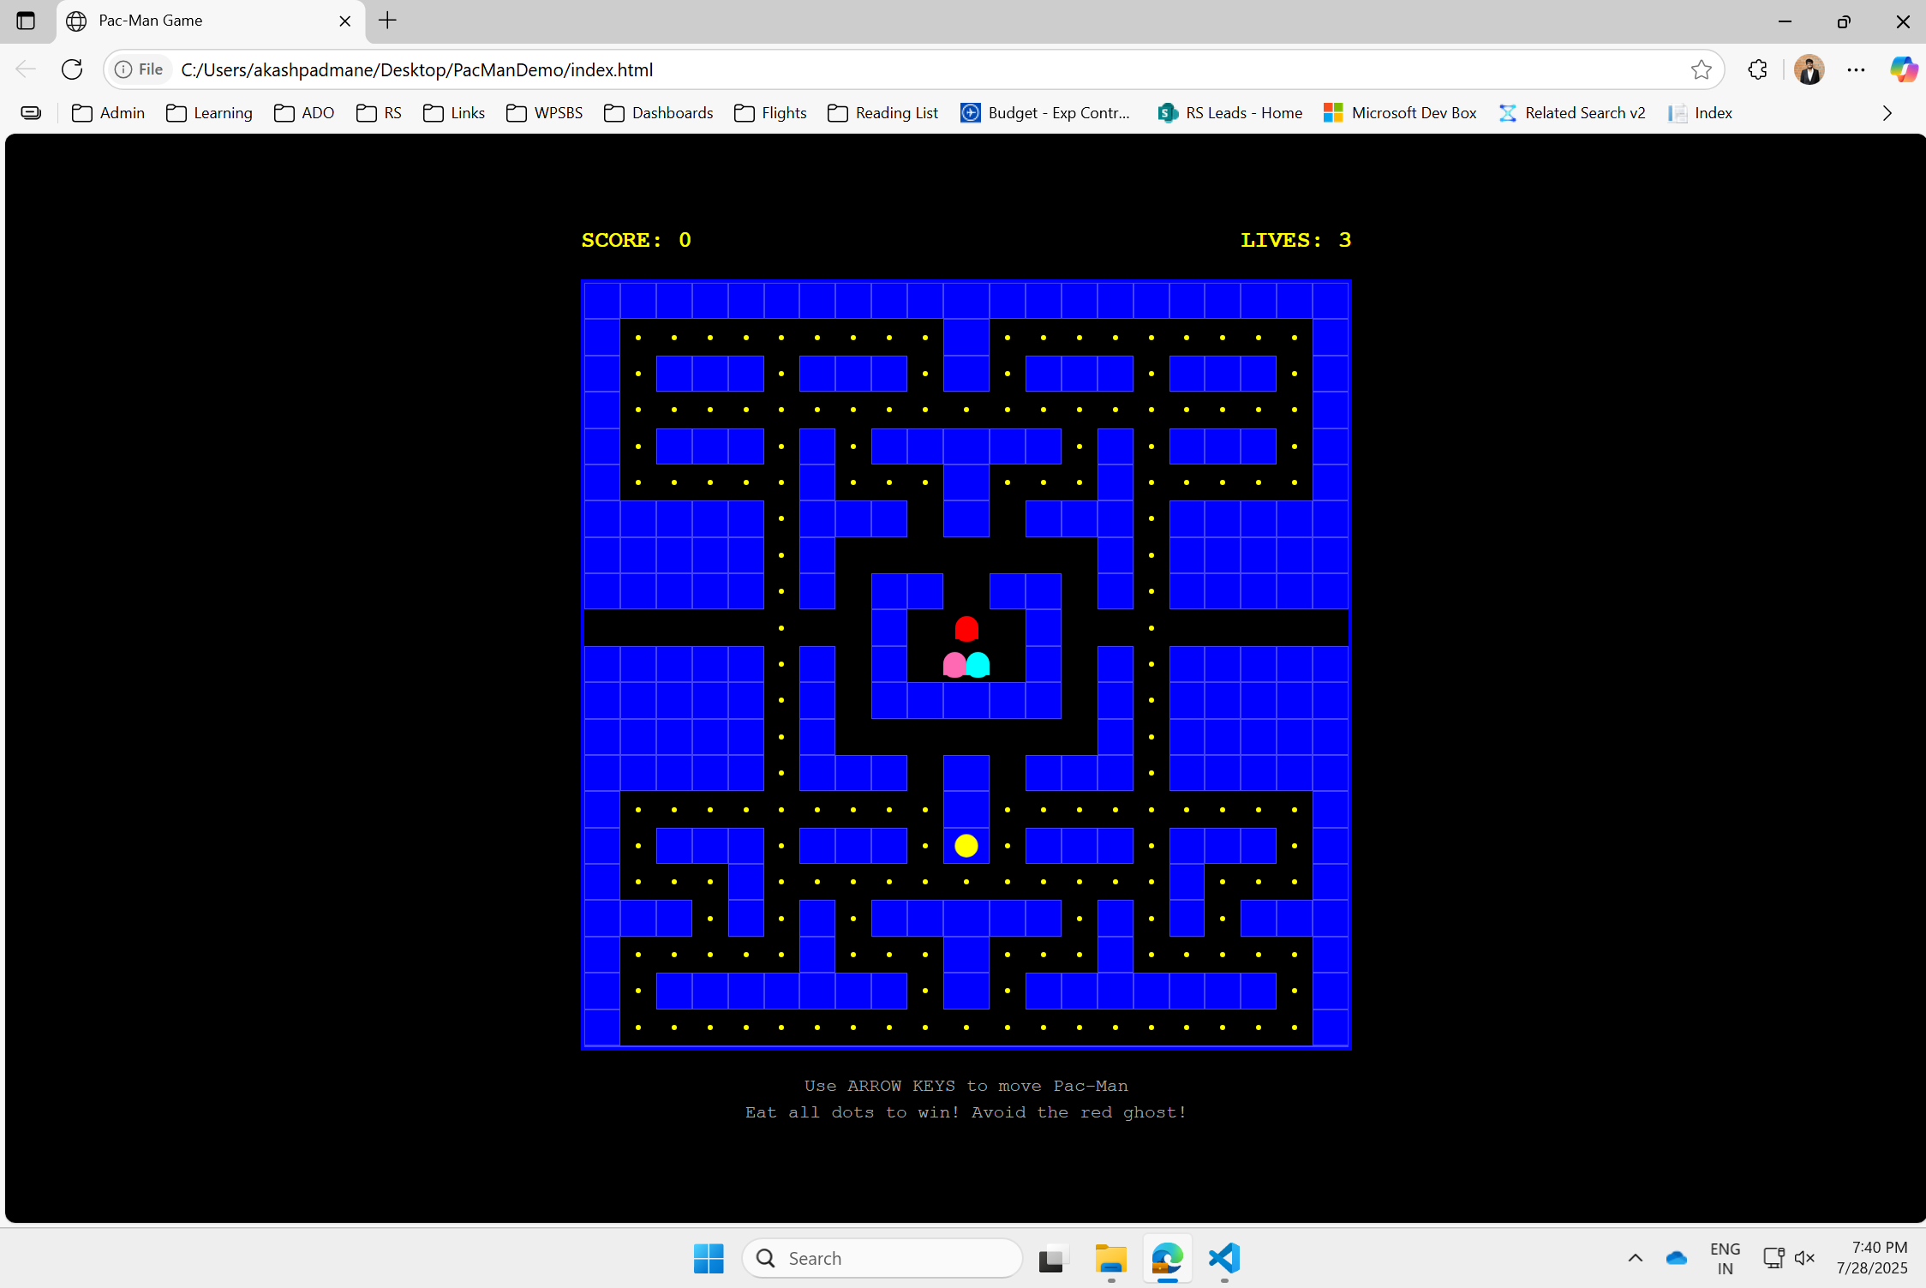
Using AI to accelerate your Innovation
Milestone #3: Adding New Features
#1: Add the prompt requesting edits in GitHub Copilot
#2: Once edits are done, re open ‘index.html’ in Edge
Notes:
Take screenshot and ask github to solve it

Slide 28
Checkpoint #6
Are you able to now add a new feature?
Yes
No

Slide 29

Using AI to accelerate your Innovation
What’s Next?
Milestone #1 Running First Game
Milestone #2 Making first Edit
Milestone #3
Adding New Features
BONUS!!
Milestone #4
Let Imagination Run Wild!
Notes:
Take screenshot and ask github to solve it

Slide 30
Let Imagination Run Wild!
“Make the pacman game in pastel color theme”
“Make the pacman game in retro game color theme”
“Make the pacman game in vibrant color themes”
“Make the pacman game such that pacman can collect power-ups scattered in the maze”

Slide 31
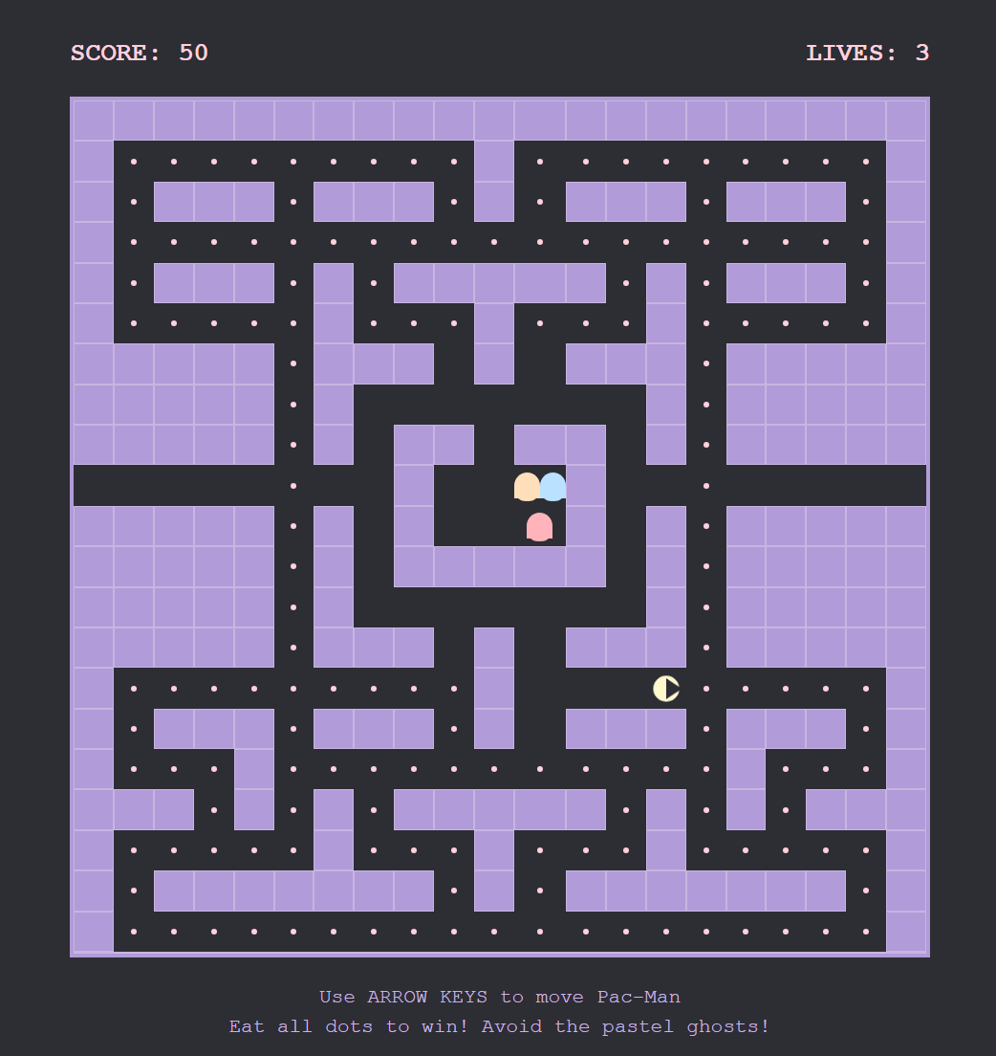
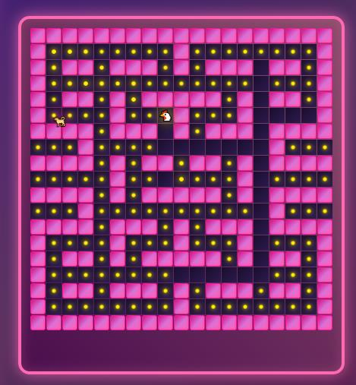
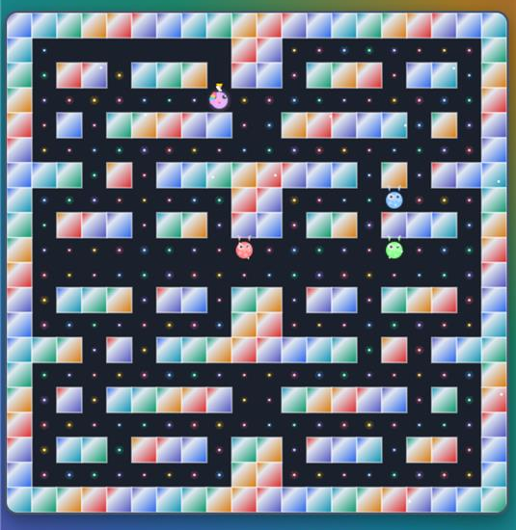
Using AI to accelerate your Innovation
Let Imagination Run Wild!
Pacman in Pastel colours
Pacman in Retro Colors
Pacman in Vibrant Colours & New Characters
Notes:
Take screenshot and ask github to solve it - sha

Slide 32





Tips: Getting the Vibe Right
Start every new project with a new folder
For better project management – learn & use Git to create branches
You can share your game with GitHub Pages (Link)
Claude Sonnet 4 best for creative tasks; Gemini 2.5 Pro for Debugging
“Ask” mode to get answers, ideas and “Agent” mode to execute

Slide 33



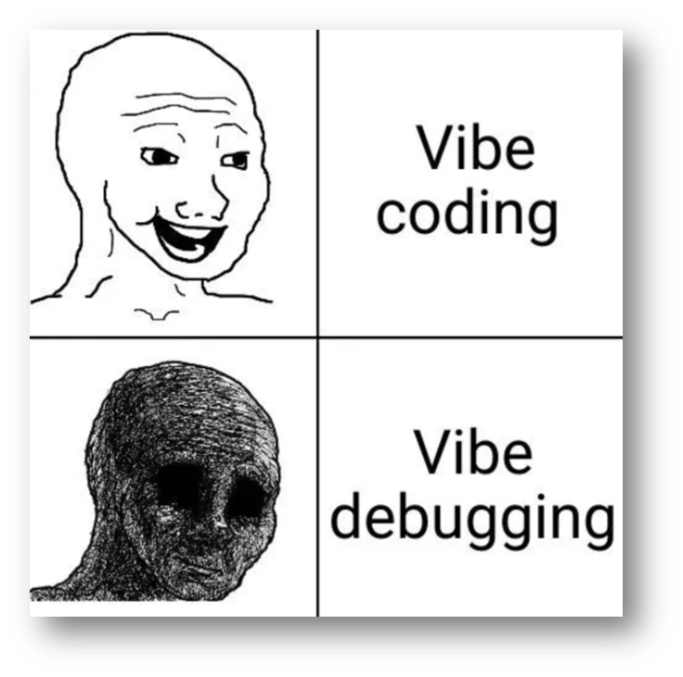
Tips: Getting the Vibe Right
Use Screenshots and images to Guide Agent Mode
To integrate LLMs in your project – leverage Azure AI Foundry
Share prompts & best-practices among your peer group

